Slide 1
JA NFP4Health – Training Online
NFP Profile: a practical tool for defining EU4Health NFPs key characteristics and peculiarities to implement EU4Health Programme“
24 November 10.30 - 12.00
This presentation is part of the action “NFP4Health” which has received funding from the European Union’s Health Programme (2014-2020) under grant agreement No 101035965.

Slide 2
Joint Action on increasing the capacity of national focal points – NFP4Health
The Joint Action on increasing the capacity building of national focal points (NFPs) – NFP4Health funded by the third Programme for the Union’s action in the field of health (2014-2020), aims at creating an innovative, sustainable, and coherent network of National Focal Points that will increase the capacity of Member States to design and create sustainable actions to promote the achievement of the health objectives for the period 2021-2027.
The webinar will be an occasion to present a very important deliverable “NFP Profile” elaborated by colleagues from ISCIII with the contribution of all Consortium and External Advisory Board, as it is strategic document defining the key characteristics and peculiarities of the EU4Health NFPs and, therefore, contribute to the strengthening of the NFPs performance and Programme Implementation. On this occasion, the EU4Health Survey on the evaluation of the NFP Profile will be launched at european level to all relevant stakeholders.
This presentation is part of the action “NFP4Health” which has received funding from the European Union’s Health Programme (2014-2020) under grant agreement No 101035965.

Slide 3
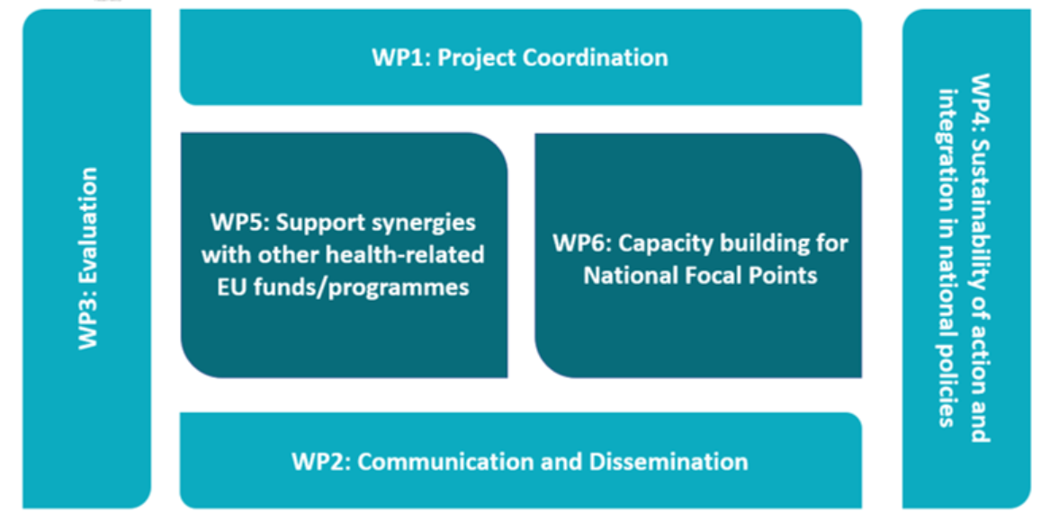
Joint Action on increasing the capacity of national focal points – NFP4Health
This presentation is part of the action “NFP4Health” which has received funding from the European Union’s Health Programme (2014-2020) under grant agreement No 101035965.

Slide 4
Joint Action on increasing the capacity of national focal points – NFP4Health
NFP Profile: the process and the tool
WP4: Sustainability of action and integration in national policies
Objective:
To define the role of National Focal Points (NFPs)
To integrate lessons learned from evidence – based policy initiatives and key recommendations
This presentation is part of the action “NFP4Health” which has received funding from the European Union’s Health Programme (2014-2020) under grant agreement No 101035965.

Slide 5
Joint Action on increasing the capacity of national focal points – NFP4Health
WP4: Sustainability of action and integration in national policies
Task 4.1 NFP Sustainability Assessment
The Assessment activity had the objective to:
Map NFPs needs, activities and roles during the implementation of previous EU4Health programmes (state of the art)
Identify new NFPs functions and challenges towards EU4Health
This presentation is part of the action “NFP4Health” which has received funding from the European Union’s Health Programme (2014-2020) under grant agreement No 101035965.

Slide 6
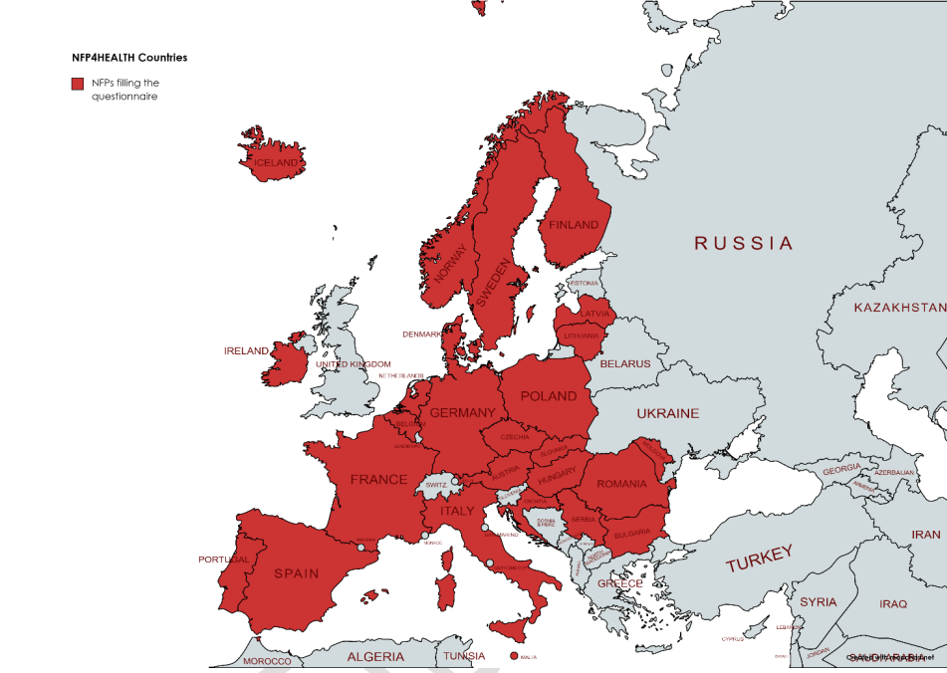
Joint Action on increasing the capacity of national focal points – NFP4Health
WP4: Sustainability of action and integration in national policies
Task 4.1 NFP Sustainability Assessment
Deliverable Interim Report on NFPs Organizational models (May 2022) → a comparative assessment of the different organisational models implemented by the NFPs
The questionnaire has been filled-in by 26 representatives of Members States → 69%
This presentation is part of the action “NFP4Health” which has received funding from the European Union’s Health Programme (2014-2020) under grant agreement No 101035965.

Slide 7
Joint Action on increasing the capacity of national focal points – NFP4Health
Key Points: Interim Report on NFPs organizational models
Overview of the organizations where NFPs are nested
Organization main activities as a whole
Targeted stakeholders
Experience of NFPs (years, Health programs, projects)
Dedicated staff
Overview of cultural background
Engagement strategies
Websites, leaflets, newsletters, email, webinar, training courses etc)
Feedback from stakeholders
Content disseminated
Budget invested
This presentation is part of the action “NFP4Health” which has received funding from the European Union’s Health Programme (2014-2020) under grant agreement No 101035965.

Slide 8
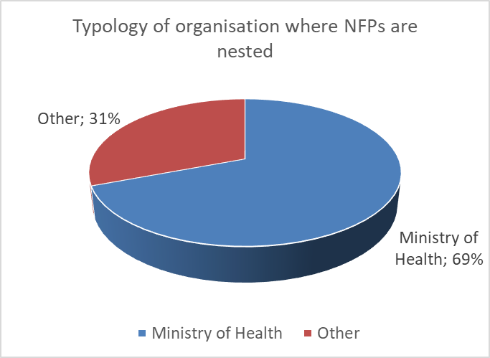
Joint Action on increasing the capacity of national focal points – NFP4Health
WP4: Sustainability of action and integration in national policies
Typology of organisation where NFPs are nested: 69% NFPs; 31% Other
This presentation is part of the action “NFP4Health” which has received funding from the European Union’s Health Programme (2014-2020) under grant agreement No 101035965.

Slide 9
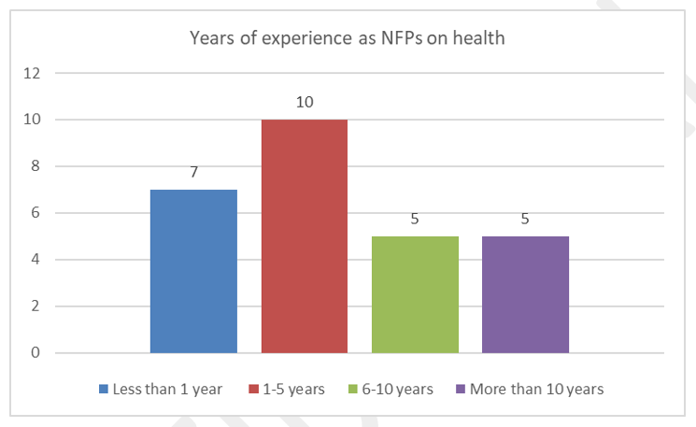
Joint Action on increasing the capacity of national focal points – NFP4Health
WP4: Sustainability of action and integration in national policies
The length of experience accumulated as NFP of the Public Health Programme has been investigated
This presentation is part of the action “NFP4Health” which has received funding from the European Union’s Health Programme (2014-2020) under grant agreement No 101035965.

Slide 10
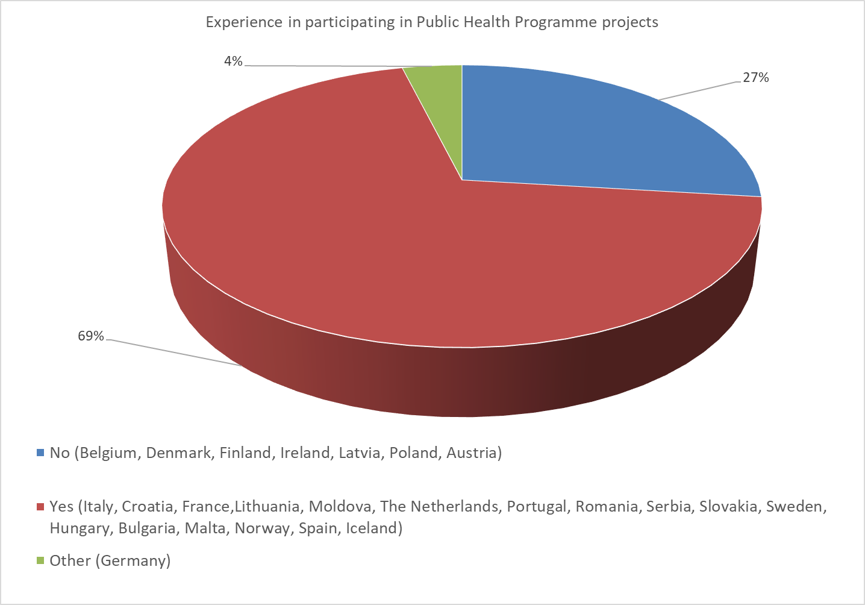
Joint Action on increasing the capacity of national focal points – NFP4Health
WP4: Sustainability of action and integration in national policies
The vast majority of NFPs (69% of the respondents) report significant experience in participating in Public Health Programme projects
This presentation is part of the action “NFP4Health” which has received funding from the European Union’s Health Programme (2014-2020) under grant agreement No 101035965.

Slide 11
Joint Action on increasing the capacity of national focal points – NFP4Health
WP4: Sustainability of action and integration in national policies
Next Steps:
Improvement of actions regarding the assistance to stakeholders
Raise awareness about the Role of the NFP service
Significant basis for the construction of the NFP Profile
Results emerging will foresee further and dedicated in-depth study activities, also within the framework of the planned on-site/ online training activities.
This presentation is part of the action “NFP4Health” which has received funding from the European Union’s Health Programme (2014-2020) under grant agreement No 101035965.

Slide 12
Joint Action on increasing the capacity of national focal points – NFP4Health
WP6: Capacity building for National Focal Points
Foster NFPs knowledge and skills of the NFPs in the EU Member States and associated countries
Promote the equality of opportunities for all EU Member States in accessing the EU4Health programme
Fill in the knowledge gap with respect to the transition from the old to the new programme, delivering a detailed training plan, addressing all NFPs
This presentation is part of the action “NFP4Health” which has received funding from the European Union’s Health Programme (2014-2020) under grant agreement No 101035965.

Slide 13
Joint Action on increasing the capacity of national focal points – NFP4Health
WP6: Training Programme
Training Online: maximum of 20 webinars on specific needs, expertise and technical knowledge, with the focus being enhancing knowledge sharing, peer learning and capacity building
Training Onsite: 2 Modules, 5 itinerant editions each ill include a mix of technical and soft skills, stimulate interaction, teambuilding, synergies and the exchange of experiences, identify specific needs and doubts and to fill the eventual gaps
The training focuses on:
Technical skills: in terms of EU4Health Programme knowledge, genesis and implementation (including synergies in the framework of the whole EU 2021 – 2027 Programming )
Soft skills: in terms of developing concrete personal and professional tools in order to perform the role of NFPs
This presentation is part of the action “NFP4Health” which has received funding from the European Union’s Health Programme (2014-2020) under grant agreement No 101035965.

Slide 14
Joint Action on increasing the capacity of national focal points – NFP4Health
WP6: Training Programme
Needs assessment and elaboration of data
In order to assess the needs of NFPs, the Italian Ministry of Health and ProMIS created an online questionnaire with the aim to identify specific needs of the NFPs and to adapt and organize the activities of the Training Programme.
With the collaboration of WP3 Leader, ProMIS will take care that the Training will have a strong impact on NFPs performance
This presentation is part of the action “NFP4Health” which has received funding from the European Union’s Health Programme (2014-2020) under grant agreement No 101035965.

Slide 15
Joint Action on increasing the capacity of national focal points – NFP4Health
NFP Profile
This document has the objective to provide an update and a practical tool targeting the NFPs in order to frame the mission, profile, functions, and tasks. This document will be updated periodically
This presentation is part of the action “NFP4Health” which has received funding from the European Union’s Health Programme (2014-2020) under grant agreement No 101035965.

Slide 16
Joint Action on increasing the capacity of national focal points – NFP4Health
NFP Profile: Launch of the Stakeholder Survey
The survey is aiming at collecting the feedback from the relevant stakeholders at EU level as the NFP Profile is a technical deliverable defining the role of the NFP service and, therefore, contributing to the EU4Health programme implementation support
This presentation is part of the action “NFP4Health” which has received funding from the European Union’s Health Programme (2014-2020) under grant agreement No 101035965.

Slide 17
Joint Action on increasing the capacity of national focal points – NFP4Health
NFP Profile
Introduction
Mission
Functions and Tasks
Key Principles
Nomination Process
Confidentiality
Conflict of Interest
This presentation is part of the action “NFP4Health” which has received funding from the European Union’s Health Programme (2014-2020) under grant agreement No 101035965.

Slide 18
Joint Action on increasing the capacity of national focal points – NFP4Health
NFP Profile - Mission
“Essential role in delivering the programme’s objectives and impacts thus enhancing an increased participation at national level. Acting as the national experts for the Health Programme in EU countries, the NFPs support the Programme implementation by ensuring the equitable participation to the Programme and the dissemination of its results”
This presentation is part of the action “NFP4Health” which has received funding from the European Union’s Health Programme (2014-2020) under grant agreement No 101035965.

Slide 19
Joint Action on increasing the capacity of national focal points – NFP4Health
NFP Profile – Functions and Tasks
Informing and awareness raising
Promulgate general and specific documentation on the EU4Health Programme (Annual Work Programme, Stakeholders Consultations...etc.)
Organize promotional events and info days at the national level with the aim to:
promote the Annual Work Programme – in liaison the European Commission and the European Health and Digital Executive Agency (HaDEA).
disseminate the results
inform on the impact generated by the Programme at the national level
Raise awareness of:
Funding opportunities under the EU4Health Programme published in the Funding&Tenders Portal
Synergies with other health related programmes at european/national level
This presentation is part of the action “NFP4Health” which has received funding from the European Union’s Health Programme (2014-2020) under grant agreement No 101035965.

Slide 20
Joint Action on increasing the capacity of national focal points – NFP4Health
NFP Profile – Functions and Tasks
Support and capacity building
Support potential applicants with the participation to the Programme aiming at increasing the participation and the performance
Explain the scope and the modalities of types of action foreseen in EU4Health as well as ensuring that the proposals fall under the financial framework
Organise courses and training sessions to strengthening knowledge of relevant stakeholders
This presentation is part of the action “NFP4Health” which has received funding from the European Union’s Health Programme (2014-2020) under grant agreement No 101035965.

Slide 21
Joint Action on increasing the capacity of national focal points – NFP4Health
NFP Profile – Key Principles
Member States/Associated Countries Responsibility
Ensure Confidentiality / Avoid Conflict of interest
Ensure Transparency and equal access
Set up dedicated info – page dedicated to the EU4Health Programme and in accordance to relevant portals (EU Commission, HaDEA / tools) and ensure efficient communication channel
Identify opportunities by related programmes
Active participation in transnational networks and develop strategic relationships
Acquire technical/soft skills
This presentation is part of the action “NFP4Health” which has received funding from the European Union’s Health Programme (2014-2020) under grant agreement No 101035965.

Slide 22
Joint Action on increasing the capacity of national focal points – NFP4Health
NFP Profile – Nomination Process
(EU) No 282/2014 on the establishment of a third Programme for the Union's action in the field of health (2014-2020) Article 15, “Member States shall designate National Focal Points which shall assist the Commission in the promotion of the Programme and, as appropriate, the dissemination of the results of the Programme and the available information on the impact of the Programme as referred to in Article 13(2)”. | (EU) 2021/522 establishing a Programme for the EU’s action in the field of health (EU4Health Programme) for the period 2021 Recital 55, “Member States and participating countries have designated NFPs to assist the Commission in the promotion of the third Programme for the Union’s action in the field of health (2014-2020) established by Regulation (EU) No 282/2014, and, where relevant, in the dissemination of its results and the information available on its impact in the Member States and participating countries
This presentation is part of the action “NFP4Health” which has received funding from the European Union’s Health Programme (2014-2020) under grant agreement No 101035965.

Slide 23
Joint Action on increasing the capacity of national focal points – NFP4Health
Thank you for attention
Janfp4health.italy@gmail.com
Website: JA NFP4Health
This presentation is part of the action “NFP4Health” which has received funding from the European Union’s Health Programme (2014-2020) under grant agreement No 101035965.

