Slide 1
NFP TEAM ORGANIZATION
WORKSHOP 1
Wien
21 November 2022
This presentation is part of the action “NFP4Health” which has received funding from the European Union’s Health Programme (2014-2020) under grant agreement No 101035965.

Slide 2
WORKSHOP 1
The NFP IDENTIKIT
EXPECTED GOAL
Through the appointment of the National Focal Points, Member States have been supporting the implementation of the Health Programme, thus enhancing an increased participation at national level
This presentation is part of the action “NFP4Health” which has received funding from the European Union’s Health Programme (2014-2020) under grant agreement No 101035965.

Slide 3
ACTIVITIES
Provide professional support services for national applicants
Sharing knowledge and good practices among MS and within their national health community
Contribute to the implementation of the Programme through regular cooperation with the Commission’s implementing services
Submit available information on the implementation and impact of the Programme to national bodies
Support the Commission’s implementing services in monitoring the implementation of the actions
This presentation is part of the action “NFP4Health” which has received funding from the European Union’s Health Programme (2014-2020) under grant agreement No 101035965.

Slide 4
Key Responsibilities
Coordination of the NFP focusing on the new EU4Health programme
implementing synergies with local/regional programs,
maximizing the impact and use of funds for improving the quality and transnational collaboration of health systems across Europe.
This presentation is part of the action “NFP4Health” which has received funding from the European Union’s Health Programme (2014-2020) under grant agreement No 101035965.

Slide 5
Possible Tasks
Representing NFP in EU, think tanks and other relevant stakeholders meetings, events, networking groups and through social media channels;
Help partners to execute strategic projects related to EU4Health and other programs;
Promote the connection among stakeholders, boosting their participation, facilitation;
Know the EU opportunities and train/disseminate them to a wider public;
Support partners in the submission of proposals for EU calls
This presentation is part of the action “NFP4Health” which has received funding from the European Union’s Health Programme (2014-2020) under grant agreement No 101035965.

Slide 6
This presentation is part of the action “NFP4Health” which has received funding from the European Union’s Health Programme (2014-2020) under grant agreement No 101035965.

Slide 7
The National Focal Point IDENTIKIT CARD
This presentation is part of the action “NFP4Health” which has received funding from the European Union’s Health Programme (2014-2020) under grant agreement No 101035965.

Slide 8
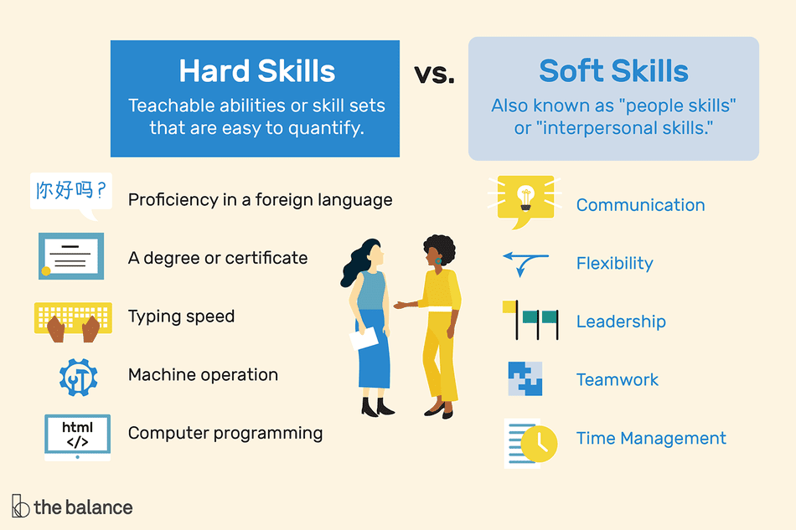
This presentation is part of the action “NFP4Health” which has received funding from the European Union’s Health Programme (2014-2020) under grant agreement No 101035965.

Slide 9
The National Focal Point IDENTIKIT CARD
TECHNICAL SKILLS
Political or social science, public policy, communications, or any other relevant area related with EU policies and health
Work experience, preferably with a European institution, association or organisation or a consultancy working on EU related topics;
Very good understanding of the political and cultural specificities of the Brussels political scene; strong and impactful relations with a wide range of stakeholders;
Very strong project management skills for complex international projects, including financial and personnel management, leadership, and decision-making;
Experience in citizen and stakeholder engagement strategies;
Good command of the Microsoft Office Suite, particularly PowerPoint, Word, Excel, etc.;
Ability to work in a digital environment, familiarity with IT tools and remote working
This presentation is part of the action “NFP4Health” which has received funding from the European Union’s Health Programme (2014-2020) under grant agreement No 101035965.

Slide 10
The National Focal Point IDENTIKIT CARD
Outgoing, solution-oriented, stress resilient and flexible personality;
Strong interpersonal skills, including being an articulate speaker and strong listener;
Excellent analytical, writing and presentation skills;
Able to work in a growth-oriented, collaborative, and fast-paced environment.
This presentation is part of the action “NFP4Health” which has received funding from the European Union’s Health Programme (2014-2020) under grant agreement No 101035965.

Slide 11
More info….to be continued
This presentation is part of the action “NFP4Health” which has received funding from the European Union’s Health Programme (2014-2020) under grant agreement No 101035965.

Slide 12
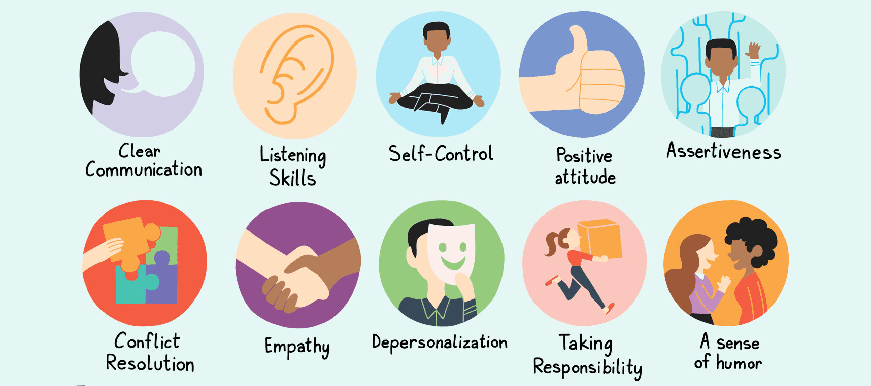
SOFT SKILLS
This presentation is part of the action “NFP4Health” which has received funding from the European Union’s Health Programme (2014-2020) under grant agreement No 101035965.

Slide 13
The National Focal Point IDENTIKIT CARD
This presentation is part of the action “NFP4Health” which has received funding from the European Union’s Health Programme (2014-2020) under grant agreement No 101035965.

Slide 14
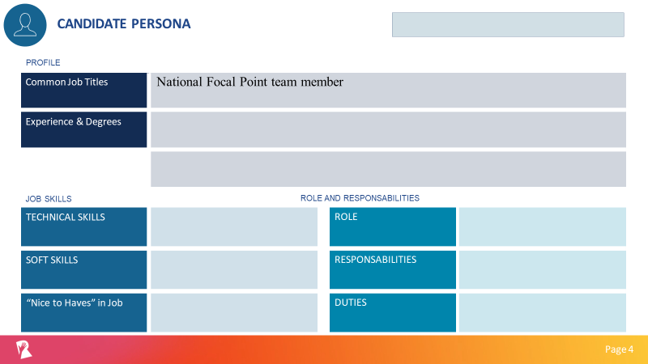
This presentation is part of the action “NFP4Health” which has received funding from the European Union’s Health Programme (2014-2020) under grant agreement No 101035965.

Slide 15
Group 1
Cara Pries | GOG
Iwanek Artur | MoH Poland
Cristina Medina | FPS Spain
Francesca Gastaldon | ProMIS
Group 2
Irene Mikulcik | GOG
Sandita Florea | ProMIS
Daniela Plescia | It MoH
Leticia Copano | MoH Spain
Sienko Kinga | MoH Poland
Group 3
Johanna Florian | AT Ministry of Health
Drazek Katarzyna | MoH Poland
Milena Vasic | Institute of Public Health Serbia
Tamara Munoz | FPS
This presentation is part of the action “NFP4Health” which has received funding from the European Union’s Health Programme (2014-2020) under grant agreement No 101035965.

Slide 16
The National Focal Point IDENTIKIT CARD
This presentation is part of the action “NFP4Health” which has received funding from the European Union’s Health Programme (2014-2020) under grant agreement No 101035965.

