Slide 1
JA NFP4Health
Communication
This presentation is part of the action “NFP4Health” which has received funding from the European Union’s Health Programme (2014-2020) under grant agreement No 101035965.

Slide 2
The GOAL of the Communication WP
To facilitate internal and external communication
The project partners and all other stakeholders are aware of the JA's objectives, actions, results, and deliverables
To provide informational support for all NFPs connected via NFP4Health Project in order to help them in their role
To spread important information to wider national / regional audience
This presentation is part of the action “NFP4Health” which has received funding from the European Union’s Health Programme (2014-2020) under grant agreement No 101035965.

Slide 3
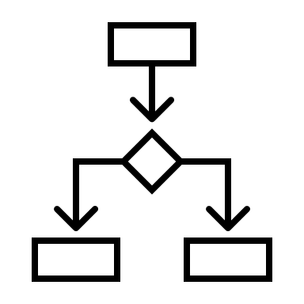
JA NFP4Health Communication Streams
Project Consortium and Associated countries
To strengthen the nexus among NFP network.
NFPs network
To assist NFPs and help them fulfill their mission.
External stakeholders and organizations
To foster the cooperation of NFP network with other relevant professional networks and partnerships and to maximize the potential of NFP network.
This presentation is part of the action “NFP4Health” which has received funding from the European Union’s Health Programme (2014-2020) under grant agreement No 101035965.

Slide 4
JA NFP4Health Communication Streams: Communication towards JA Consortium and Associated countries
The aim is to deliver updates and all relevant information mainly about JA status – progress of all WP's work, news, deliverables, milestones, and progress of tasks
Communication channels:
Project Newsletter;
Internal project bulletins and reports;
Communication channels intended for wider audience (webpage, social media, leaflet).
This presentation is part of the action “NFP4Health” which has received funding from the European Union’s Health Programme (2014-2020) under grant agreement No 101035965.

Slide 5
JA NFP4Health Communication Streams: Communications towards whole NFP‘s network
The aim is to deliver NFPs the information on JA NFP4Health, the organized trainings, respective events and on latest news such as open calls or partnership searches.
Communication channels:
Social media with focus on NFP4Health and associated events;
Webpage – especially part of webpage focused on Trainings, Events and News such as open calls or partnership searches;
Project Newsletter.
This presentation is part of the action “NFP4Health” which has received funding from the European Union’s Health Programme (2014-2020) under grant agreement No 101035965.

Slide 6
JA NFP4Health Communication Streams: Communication towards stakeholders on national/ regional level
The aim is to deliver updates and all relevant information JA status but also the organized trainings, respective events and latest news such as open calls or partnership searches.
And to find ways to collect feedback from stakeholders and include their views into the whole Joint Action process.
Communication channels:
Webpage;
Social media and networks;
Newsletter;
Indirectly through NFPs.
This presentation is part of the action “NFP4Health” which has received funding from the European Union’s Health Programme (2014-2020) under grant agreement No 101035965.

Slide 7
JA NFP4Health Communication Objectives
To identify stakeholders and split them into target groups based on their interests and roles.
To engage stakeholders in order to ensure that the results of the project are applicable to them.
To set up channels and tools to articulate key messages and to share outputs, recommendations, and deliverables of the JA.
To assist NFPs in their role to disseminate key messages through various spectrum of stakeholders.
This presentation is part of the action “NFP4Health” which has received funding from the European Union’s Health Programme (2014-2020) under grant agreement No 101035965.

Slide 8
JA NFP4Health Communication Channels
Website
Social Media
Twitter
LinkedIn
Newsletter
This presentation is part of the action “NFP4Health” which has received funding from the European Union’s Health Programme (2014-2020) under grant agreement No 101035965.

Slide 9
JA NFP4Health Communication Channels: Twitter
Social medium of the moment, due to its aim, purpose and limitations, we plan to share just a short messages on ongoing activities and events.
Tweets will contain:
The latest news from the project;
News and pictures from meetings or workshops;
Retweets from related twitter accounts of initiatives, partners
This presentation is part of the action “NFP4Health” which has received funding from the European Union’s Health Programme (2014-2020) under grant agreement No 101035965.

Slide 10
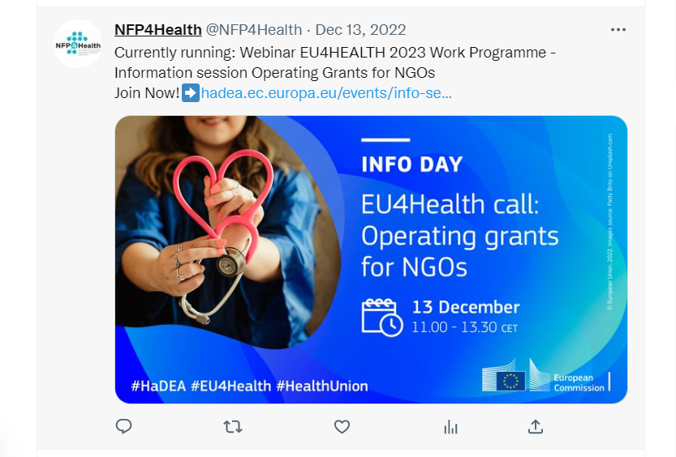
JA NFP4Health Communication Channels: Twitter
This presentation is part of the action “NFP4Health” which has received funding from the European Union’s Health Programme (2014-2020) under grant agreement No 101035965.

Slide 11
JA NFP4Health Communication Channels: LinkedIn
Enable knowledge transfer between local authorities and other stakeholders;
Share experiences and enhance collaboration;
Announce events;
Communicate outputs from meetings and workshops
This presentation is part of the action “NFP4Health” which has received funding from the European Union’s Health Programme (2014-2020) under grant agreement No 101035965.

Slide 12
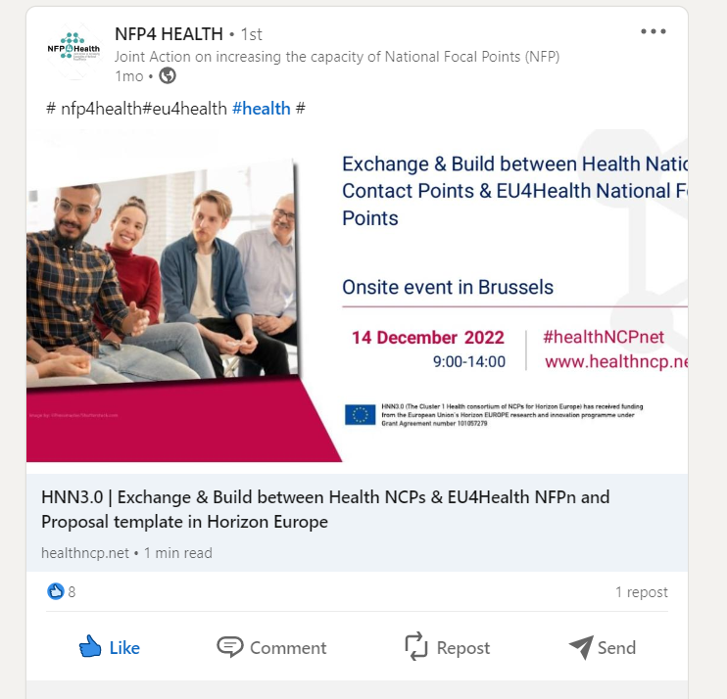
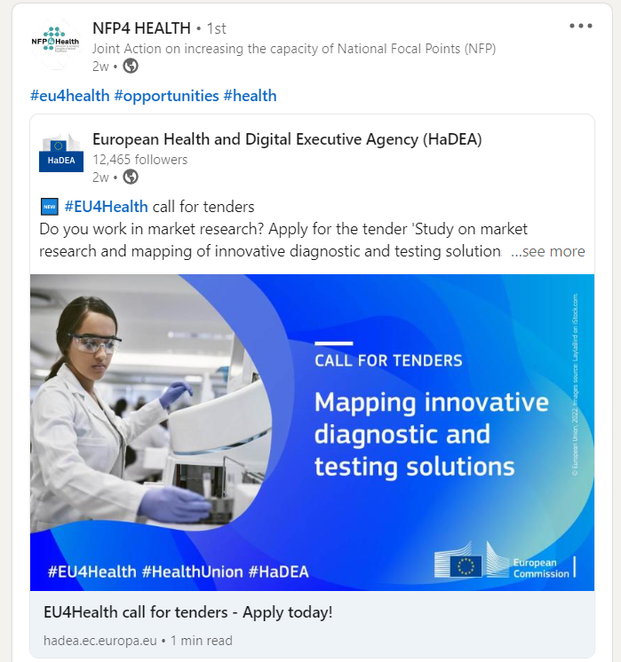
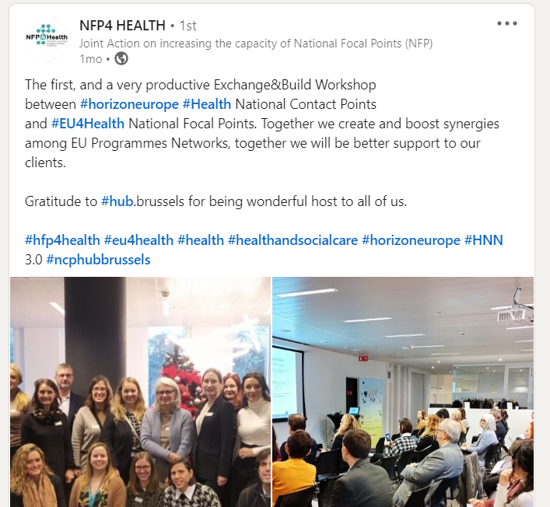
JA NFP4Health Communication Channels: LinkedIn
This presentation is part of the action “NFP4Health” which has received funding from the European Union’s Health Programme (2014-2020) under grant agreement No 101035965.

