Slide 1


Horizon Europe Programme - Health
NCP Cluster 1 Health
buonocore@apre.it
ASSOLOMBARDA
1 Marzo 2022

Slide 2
Agenda
Caterina Buonocore, EU Horizon Europe – National Contact Point HEALTH, INFRASTRUCTURE, JRC, APRE – Agency for the Promotion of European Research
11.10 | Opening
 | Horizon Europe: context, structure and main funding scheme
 | Horizon Europe Cluster “Health”: a general overview
 | Horizon Europe Cluster “Health”: funding opportunities under the WP 2023-2024 + focus su EU Partnership IHI - Innovative Health Initiative
12.30 | Closure

Slide 3
National Contact Points – NCPs
WHAT WE OFFER
  The NCPs provide information and advice to potential applicants and beneficiaries, through the project life cycle, in their own language, by a personalized approach.
Information and awareness raising
Assisting, advising, training
Signposting and cooperation

Slide 4



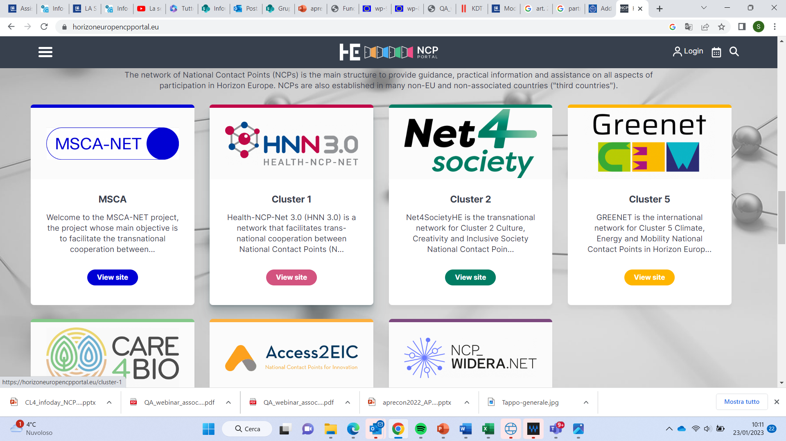





NCP NETWORKS IN HORIZON EUROPE

Slide 5
NCP projects: SERVICES FOR APPLICANTS
Annotated templates (RIA/IA)
SSH Opportunities document
Brokerage events
Topic tree
(Cluster 4 – ICT)
TRL Discovery
Full Proposal Chech events e Pre-proposal checks
Analyse of Evaluation Results & Participation
Factsheets and Guidelines;
Business Glossary;
TB.map tool (competitors)
Clinical Study template
“How to pitch”
Trainings and events
Video interview
Mappe interattive degli stakeholders più importanti
Repository
Success factors and best practices
https://horizoneuropencpportal.eu/

Slide 6

Our NCP contacts
erc@apre.it; msca@apre.it; infra@apre.it; cluster1@apre.it; cluster2@apre.it; cluster3@apre.it; cluster4@apre.it; cluster5@apre.it; cluster6@apre.it; eic@apre.it; eit@apre.it; widera@apre.it
www.apre.it
https://horizoneurope.apre.it/

Slide 7
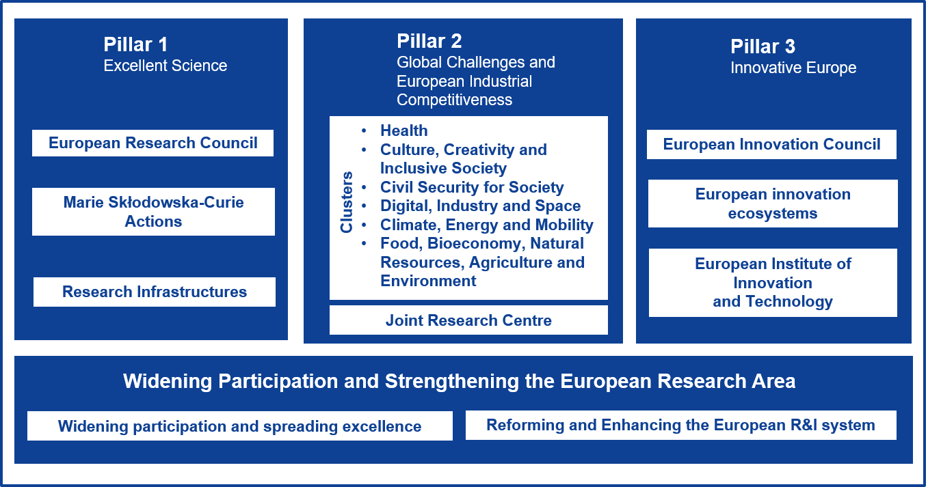
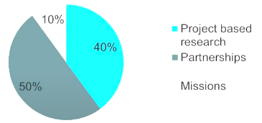
HORIZON EUROPE (2021 – 2027)
€ 95,5 billion
Pillar 2: € 53,52 bn
Health: € 8,25 bn
(15% of all Clusters)

Slide 8
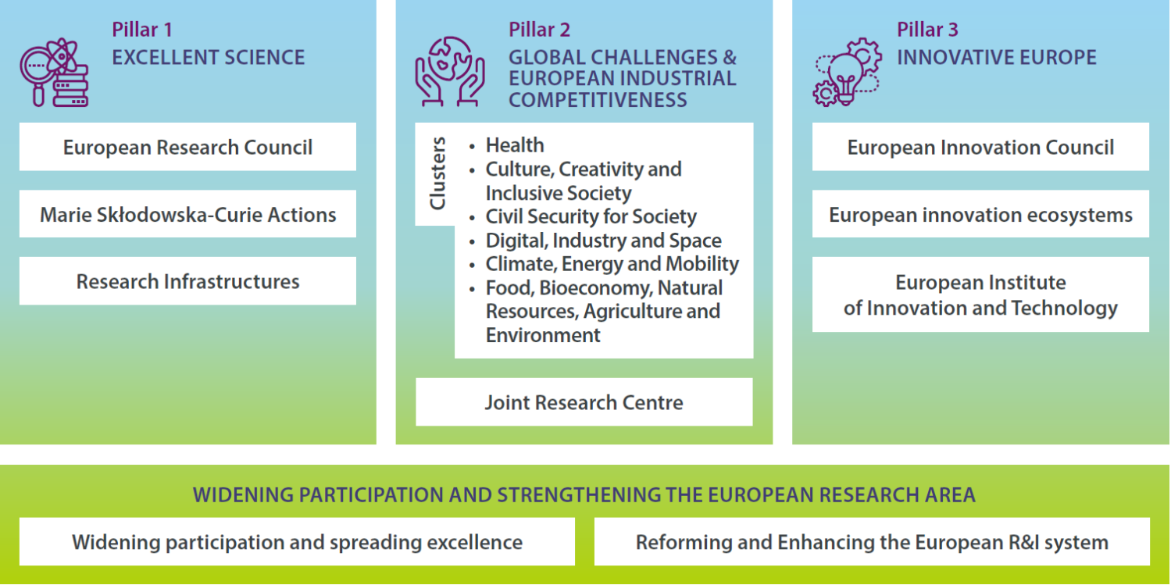
«Health» in Horizon Europe
Health in other clusters of Pillar 2: bottom up versus topdown approach

Slide 9
COMPLEMENTARITIES WITH OTHER PILLARS AND CLUSTERS
Cluster 1 Health
(Pillar II)
ERC (Pillar I)
Cluster 6 – Food, bioeconomy…
Cluster 3 – Civil security for society
Research Infrastructure
(Pillar I)
Cluster 4 – Digital, Industry and Space
Pillar III «Innovative Europe»
MSCA (Pillar I)

Slide 10
Cluster 1
Cluster 2 – Inclusive society
Cluster 6 – Food, bioeconomy…
Cluster 4 – Digital Industry and Space
Cluster 3 – Civil security for society
Cross-clusters on health in Pillar 2
Examples:
CL 2. Ageing society ..inclusive society..
CL 3. Cybersecurity of health data, protection of critical infrastructures, reaction to pandemics..
Improving response to domestic violence
CL 4. Robotics, Smart materials, training of healthcare professionals, photonics..
CL6 Food and nutritions, …

Slide 11
Main Types of Action
Action | Funding* | Main Characteristics
RIA – Research & Innovation Action | 100% + 25% | Basic and applied research, technology development and integration, testing, demonstration and validation on small-scale prototype in laboratory or simulated environment
IA – Innovation Action | 70% + 25% | Prototyping, testing, demonstrating, piloting, large-scale product validation and market replication
CSA - Coordination & Support Action | 100% + 25% | Networking, coordination or support services, policy dialogues and mutual learning exercises and studies
* Not for profit – always 100%

Slide 12

Maximum funding rates
Type of Action | Funding rate
Research and innovation action | 100%
Innovation action | 70% (except for non-profit legal entities, where a rate of up to 100% applies)
Coordination and support action | 100%
Programme co-fund action | Between 30% and 70%
Innovation and market deployment | 70% (except for non-profit legal entities, where a rate of up to 100% applies)
Training and mobility action | 100%
Pre-commercial procurement action | 100%
Public procurement of innovative solutions action | 50%
Other funding rates may be set out in the specific call conditions

Slide 13

SPECIFIC OBJECTIVES
Cluster Health
Areas of intervention
Improving and protecting the health of citizens at all ages, by developing innovative solutions to prevent, diagnose, monitor, treat and cure diseases; mitigating health risks, protecting populations and promoting good health; making public health systems more cost-effective, equitable and sustainable; and supporting and enabling patients’ participation and self-management.
Health throughout the life course
Non-communicable and rare diseases
Tools, technologies and digital solutions for health and care, including personalised medicine
Environmental and social health determinants
Infectious diseases, including poverty-related and neglected disease
Health care systems
CLUSTER 1. Health

Slide 14

EC Policy priorities for Cluster 1 Health
Directive on patients’ rights in cross-border healthcare;
Political declaration on prevention & control of non-communicable diseases;
Europe's beating cancer plan
Commission Communication on effective, accessible and resilient health systems;
Commission Communication on upgrading the single market (and its proposed health technology assessments initiative);
Council conclusions on nutrition and physical activity;
Council conclusion on personalized medicine and pharmaceuticals;
Council conclusions on strengthening the balance in the pharmaceutical systems in the EU and its Member States;
EU One Health Action Plan against Antimicrobial Resistance; Ostrava Declaration on Environment and Health;
Commission Communication on the digital transformation of health and care;
Council recommendation on strengthened cooperation against vaccine preventable diseases;
Commission Communication ‘European Plastics Strategy for a Circular Economy, Commission Communication ‘Towards a Comprehensive European Union Framework on Endocrine Disruptors’;
Commission Communication ‘European Union Strategic Approach to Pharmaceuticals in the Environment’;
EU decision on a General Union Environment Action Programme to 2020 ‘Living well, within the limits of our planet’

Slide 15
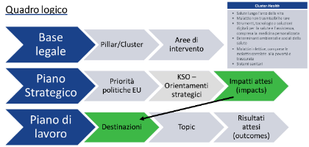
WORK PROGRAMME “HEALTH” 2023-2024
6 Destinations
Staying Healthy in a rapid changing society
Living and working in a health-promoting environment
Tackling diseases and reducing disease burden
Ensuring access to innovative, sustainable and high-quality health care
Unlocking the full potential of new tools, technologies and digital solutions for a healthy society
Maintaining an innovative, sustainable and
globally competitive health industry

Slide 16
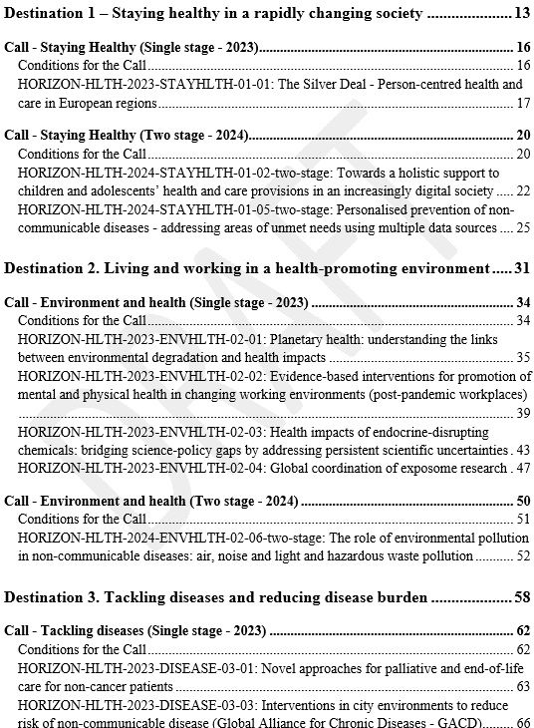
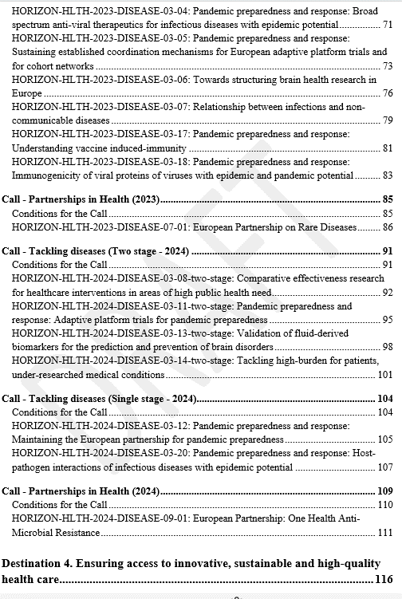
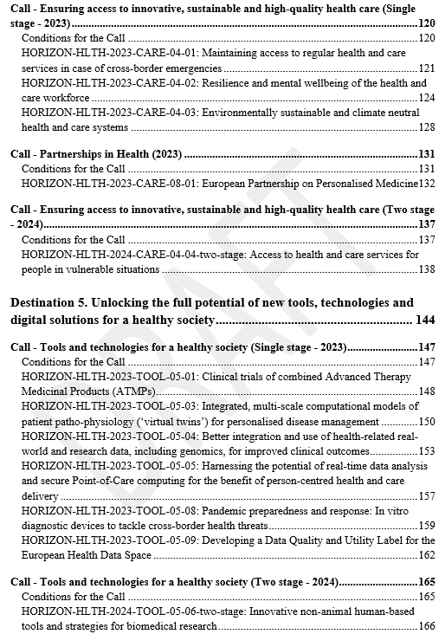
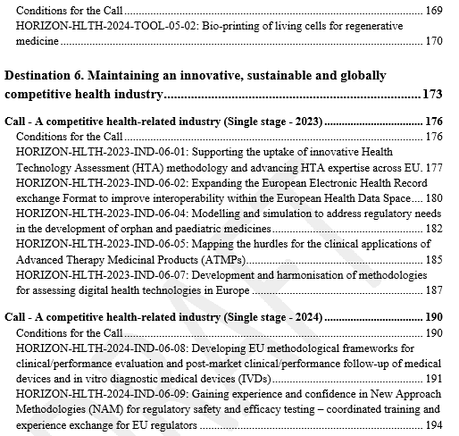

Slide 17
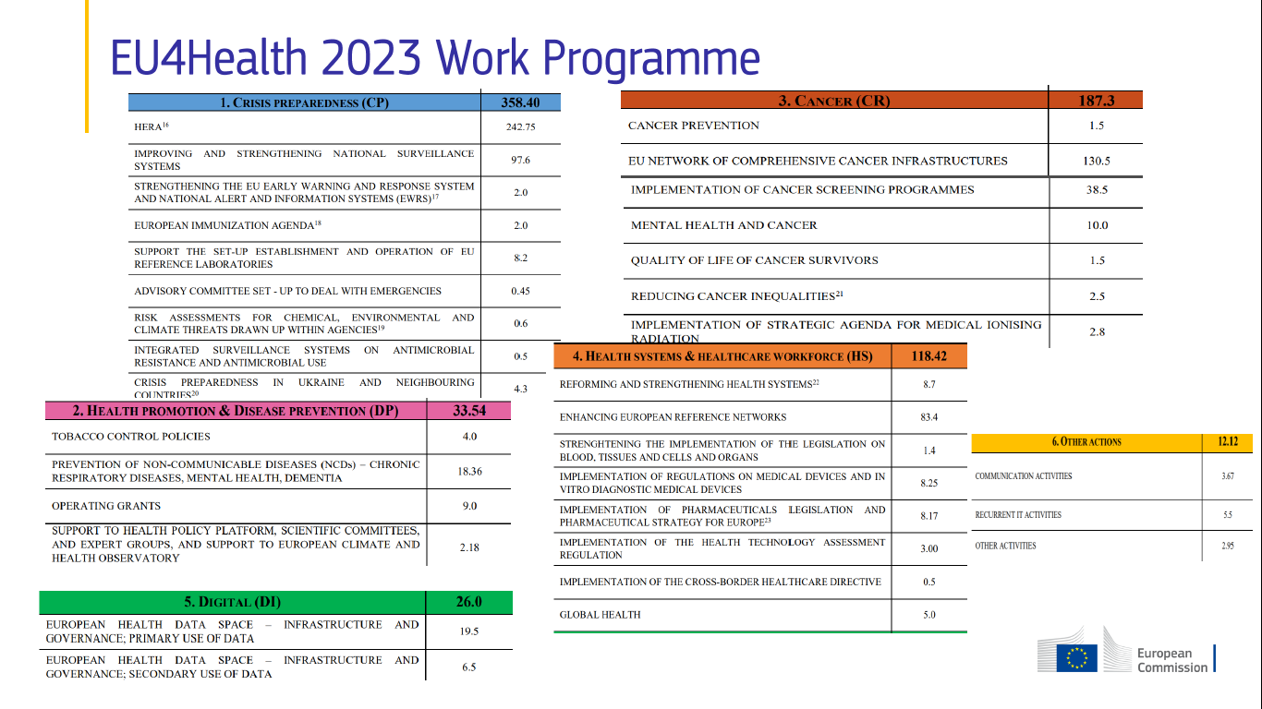


Slide 18


CLUSTER HEALTH | DESTINATION 1
Staying healthy in a rapidly changing society
Affronta le principali sfide sociali come l'obesità, l'invecchiamento e il cambiamento demografico, la salute mentale, l’empowerment nell’ambito della digital health literacy, la prevenzione personalizzata e l'Intelligenza Artificiale applicata alle malattie croniche.
  Progetti di ricerca e innovazione che forniscano nuove evidenze, metodologie e strumenti per comprendere la transizione dalla salute alla malattia.
  Budget: 120 mil Eur (40 mil Eur 2023)
TOPICS 2023:
HORIZON-HLTH-2023-STAYHLTH-01-01: The Silver Deal - Person-centred health and care in European regions - RIA
Deadline : 13 April 2023– SINGLE STAGE

Slide 19
CLUSTER HEALTH | DESTINATION 1
Staying healthy in a rapidly changing society
TOPICS 2024:
HORIZON-HLTH-2024-STAYHLTH-01-02-two-stage: Towards a holistic support to children and adolescents’ health and care provisions in an increasingly digital society – RIA-LS
HORIZON-HLTH-2024-STAYHLTH-01-05-two-stage: Personalised prevention of non-communicable diseases - addressing areas of unmet needs using multiple data sources – RIA-LS
Affronta le principali sfide sociali come l'obesità, l'invecchiamento e il cambiamento demografico, la salute mentale, l’empowerment nell’ambito della digital health literacy, la prevenzione personalizzata e l'Intelligenza Artificiale applicata alle malattie croniche.
  Progetti di ricerca e innovazione che forniscano nuove evidenze, metodologie e strumenti per comprendere la transizione dalla salute alla malattia.
  Budget: 120 mil Eur (80 mil Eur 2024)
Deadline: 19 September 2023 /11 April 2024 – TWO-STAGE

Slide 20
CLUSTER HEALTH | DESTINATION 2
Living and working in a health-promoting environment*
TOPICS 2023:
HORIZON-HLTH-2023-ENVHLTH-02-01: Planetary health: understanding the links between environmental degradation and health impacts - RIA
HORIZON-HLTH-2023-ENVHLTH-02-02: Evidence-based interventions for promotion of mental and physical health in changing working environments (post-pandemic workplaces) - RIA
HORIZON-HLTH-2023-ENVHLTH-02-03: Health impacts of endocrine-disrupting chemicals: bridging science-policy gaps by addressing persistent scientific uncertainties - RIA
HORIZON-HLTH-2023-ENVHLTH-02-04: Global coordination of exposome research - CSA
Comprendere gli impatti dell'inquinamento atmosferico indoor/outdoor, delle sostanze chimiche, dei campi elettromagnetici, dell'urbanizzazione, del cambiamento climatico e di altri cambiamenti ambientali, delle disuguaglianze socioeconomiche e del cambiamento degli ambienti di lavoro.
Rafforzare la capacità di adattamento e la resilienza delle popolazioni e dei sistemi sanitari rispetto ai rischi per la salute legati ai cambiamenti climatici e ambientali.
Budget: 163 mil Eur (103 mil Eur 2023)
* Forte connessione con European Green Deal
Deadline : 13 April 2023 – SINGLE STAGE

Slide 21
CLUSTER HEALTH | DESTINATION 2
Living and working in a health-promoting environment*
Comprendere gli impatti dell'inquinamento atmosferico indoor/outdoor, delle sostanze chimiche, dei campi elettromagnetici, dell'urbanizzazione, del cambiamento climatico e di altri cambiamenti ambientali, delle disuguaglianze socioeconomiche e del cambiamento degli ambienti di lavoro.
Rafforzare la capacità di adattamento e la resilienza delle popolazioni e dei sistemi sanitari rispetto ai rischi per la salute legati ai cambiamenti climatici e ambientali.
Budget: 163 mil Eur (60 mil Eur 2024)
TOPICS 2024:
HORIZON-HLTH-2024-ENVHLTH-02-06-two-stage: The role of environmental pollution in non-communicable diseases: air, noise and light and hazardous waste pollution – RIA-LS
Deadline: 19 September 2023 /11 April 2024 – TWO-STAGE
* Forte connessione con European Green Deal

Slide 22

CLUSTER HEALTH | DESTINATION 3
Tackling diseases and reducing disease burden*
TOPICS 2023:
HORIZON-HLTH-2023-DISEASE-03-01: Novel approaches for palliative and end-of-life care for non-cancer patients - RIA
HORIZON-HLTH-2023-DISEASE-03-03: Interventions in city environments to reduce risk of non-communicable disease (Global Alliance for Chronic Diseases - GACD) - RIA
HORIZON-HLTH-2023-DISEASE-03-04: Pandemic preparedness and response: Broad spectrum anti-viral therapeutics for infectious diseases with epidemic potential - RIA
HORIZON-HLTH-2023-DISEASE-03-05: Pandemic preparedness and response: Sustaining established coordination mechanisms for European adaptive platform trials and for cohort networks - CSA
HORIZON-HLTH-2023-DISEASE-03-06: Towards structuring brain health research in Europe - CSA
HORIZON-HLTH-2023-DISEASE-03-07: Relationship between infections and non-communicable diseases -RIA
HORIZON-HLTH-2023-DISEASE-03-17: Pandemic preparedness and response: Understanding vaccine induced-immunity - RIA
HORIZON-HLTH-2023-DISEASE-03-18: Pandemic preparedness and response: Immunogenicity of viral proteins of viruses with epidemic and pandemic potential – RIA
HORIZON-HLTH-2023-DISEASE-07-01: European Partnership on Rare Diseases – COFUND
Si concentra sulle principali sfide sociali come il cancro, le malattie non trasmissibili, le malattie rare, la resistenza antimicrobica, la vaccinazione e la preparazione alle epidemie.
  Sviluppo di nuove misure di prevenzione, terapie e tecnologie sanitarie innovative.
  Budget: 551 mil Eur (274 mil Eur 2023)
* Complementa all’ Europe’s Beating Cancer Plan e EU4Health Programme
Deadline : 13 April 2023 – SINGLE STAGE
Deadline : 19 September 2023 – SINGLE STAGE

Slide 23
CLUSTER HEALTH | DESTINATION 3*
Tackling diseases and reducing disease burden*
TOPICS 2024:
HORIZON-HLTH-2024-DISEASE-03-08-two-stage: Comparative effectiveness research for healthcare interventions in areas of high public health need – RIA-LS
HORIZON-HLTH-2024-DISEASE-03-11-two-stage: Pandemic preparedness and response: Adaptive platform trials for pandemic preparedness – RIA-LS
HORIZON-HLTH-2024-DISEASE-03-13-two-stage: Validation of fluid-derived biomarkers for the prediction and prevention of brain disorders – RIA-LS
HORIZON-HLTH-2024-DISEASE-03-14-two-stage: Tackling high-burden for patients, under-researched medical conditions – RIA-LS
HORIZON-HLTH-2024-DISEASE-03-12: Pandemic preparedness and response: Maintaining the European partnership for pandemic preparedness - CSA
HORIZON-HLTH-2024-DISEASE-03-20: Pandemic preparedness and response: Host-pathogen interactions of infectious diseases with epidemic potential – RIA
HORIZON-HLTH-2024-DISEASE-09-01: European Partnership: One Health Anti-Microbial Resistance - COFUND
Si concentra sulle principali sfide sociali come il cancro, le malattie non trasmissibili, le malattie rare, la resistenza antimicrobica, la vaccinazione e la preparazione alle epidemie.
  Sviluppo di nuove misure di prevenzione, terapie e tecnologie sanitarie innovative.
  Budget: 551 mil Eur (277 mil Eur 2024)
Deadline: 19 September 2023 /11 April 2024 – TWO-STAGE
* Complementa all’ Europe’s Beating Cancer Plan e EU4Health Programme
* Complementa all’ Europe’s Beating Cancer Plan e EU4Health Programme
Deadline: 11 April 2024– SINGLE STAGE
Deadline: 11 April 2024 – SINGLE STAGE

Slide 24

CLUSTER HEALTH | DESTINATION 4
Ensuring access to innovative, sustainable and high-quality care*
TOPICS 2023:
HORIZON-HLTH-2023-CARE-04-01: Maintaining access to regular health and care services in case of cross-border emergencies - RIA
HORIZON-HLTH-2023-CARE-04-02: Resilience and mental wellbeing of the health and care workforce - RIA
HORIZON-HLTH-2023-CARE-04-03: Environmentally sustainable and climate neutral health and care systems - RIA
HORIZON-HLTH-2023-CARE-08-01: European Partnership on Personalised Medicine – COFUND
Sviluppo e adozione di soluzioni sicure, convenienti e incentrate sulle persone, con particolare attenzione alla salute della popolazione, alla resilienza dei sistemi sanitari e alle politiche sanitarie basate sull'evidenza scientifica.
  R&I per supportare i sistemi sanitari nella loro trasformazione per garantire un accesso equo a servizi sanitari sostenibili di alta qualità per tutti i cittadini.
  Budget: 190 mil Eur (160 mil Eur 2023)
Deadline : 13 April 2023 – SINGLE STAGE
* Forte sinergia con EU4Health Programme

Slide 25
CLUSTER HEALTH | DESTINATION 4
Ensuring access to innovative, sustainable and high-quality care*
TOPICS 2024:
HORIZON-HLTH-2024-CARE-04-04-two-stage: Access to health and care services for people in vulnerable situations – RIA-LS
Sviluppo e adozione di soluzioni sicure, convenienti e incentrate sulle persone, con particolare attenzione alla salute della popolazione, alla resilienza dei sistemi sanitari e alle politiche sanitarie basate sull'evidenza scientifica.
  R&I per supportare i sistemi sanitari nella loro trasformazione per garantire un accesso equo a servizi sanitari sostenibili di alta qualità per tutti i cittadini.
  Budget: 190 mil Eur (30 mil Eur 2024)
Deadline: 19 September 2023 /11 April 2024 – TWO-STAGE
* Forte sinergia con EU4Health Programme

Slide 26

CLUSTER HEALTH | DESTINATION 5
Unlocking the full potential of new tools, technologies and digital solutions for a healthy society*
TOPICS 2023:
HORIZON-HLTH-2023-TOOL-05-01: Clinical trials of combined Advanced Therapy Medicinal Products (ATMPs) - RIA
HORIZON-HLTH-2023-TOOL-05-03: Integrated, multi-scale computational models of patient patho-physiology (‘virtual twins’) for personalised disease management - RIA
HORIZON-HLTH-2023-TOOL-05-04: Better integration and use of health-related real-world and research data, including genomics, for improved clinical outcomes - RIA
HORIZON-HLTH-2023-TOOL-05-05: Harnessing the potential of real-time data analysis and secure Point-of-Care computing for the benefit of person-centred health and care delivery - IA
HORIZON-HLTH-2023-TOOL-05-08: Pandemic preparedness and response: In vitro diagnostic devices to tackle cross-border health threats - IA
HORIZON-HLTH-2023-TOOL-05-09: Developing a Data Quality and Utility Label for the European Health Data Space - CSA
Promuovere lo sviluppo di strumenti, tecnologie e soluzioni digitali per trattamenti, farmaci, dispositivi medici, tenendo in considerazione sicurezza, efficacia, adeguatezza, accessibilità e valore aggiunto.
  I dati sanitari e gli strumenti analitici innovativi vengono utilizzati in modo sicuro ed etico.
  Budget: 264 mil Eur (214 mil Eur 2023)
* [!] European Health Data Space per promuovere lo scambio di dati sanitari e la ricerca transfrontaliera.
Deadline : 13 April 2023 – SINGLE STAGE

Slide 27
CLUSTER HEALTH | DESTINATION 5
Unlocking the full potential of new tools, technologies and digital solutions for a healthy society*
TOPICS 2024:
HORIZON-HLTH-2024-TOOL-05-02: Bio-printing of living cells for regenerative medicine - RIA
HORIZON-HLTH-2024-TOOL-05-06-two-stage: Innovative non-animal human-based tools and strategies for biomedical research – RIA-LS
Promuovere lo sviluppo di strumenti, tecnologie e soluzioni digitali per trattamenti, farmaci, dispositivi medici, tenendo in considerazione sicurezza, efficacia, adeguatezza, accessibilità e valore aggiunto.
  I dati sanitari e gli strumenti analitici innovativi vengono utilizzati in modo sicuro ed etico.
  Budget: 264 mil Eur (50 mil Eur 2024)
Deadline: 11 April 2024– SINGLE STAGE
Deadline: 19 September 2023 /11 April 2024 – TWO-STAGE
* [!] European Health Data Space per promuovere lo scambio di dati sanitari e la ricerca transfrontaliera.

Slide 28

CLUSTER HEALTH | DESTINATION 6
Maintaining an innovative, sustainable and globally competitive health industry
TOPICS 2023:
HORIZON-HLTH-2023-IND-06-01: Supporting the uptake of innovative Health Technology Assessment (HTA) methodology and advancing HTA expertise across EU - CSA
HORIZON-HLTH-2023-IND-06-02: Expanding the European Electronic Health Record exchange Format to improve interoperability within the European Health Data Space - RIA
HORIZON-HLTH-2023-IND-06-04: Modelling and simulation to address regulatory needs in the development of orphan and paediatric medicines - RIA
HORIZON-HLTH-2023-IND-06-05: Mapping the hurdles for the clinical applications of Advanced Therapy Medicinal Products (ATMPs) - CSA
HORIZON-HLTH-2023-IND-06-07: Development and harmonisation of methodologies for assessing digital health technologies in Europe - RIA
Adozione di tecnologie e innovazioni rivoluzionarie in grado di integrare gli attori della catena del valore.
  L'industria sanitaria dell'UE è più competitiva, sostenibile e strategicamente autonoma.
  Budget: 68 mil Eur (56 mil Eur 2023)
Deadline : 13 April 2023 – SINGLE STAGE

Slide 29
CLUSTER HEALTH | DESTINATION 6
Maintaining an innovative, sustainable and globally competitive health industry
TOPICS 2024:
HORIZON-HLTH-2024-IND-06-08: Developing EU methodological frameworks for clinical/performance evaluation and post-market clinical/performance follow-up of medical devices and in vitro diagnostic medical devices (IVDs) - RIA
HORIZON-HLTH-2024-IND-06-09: Gaining experience and confidence in New Approach Methodologies (NAM) for regulatory safety and efficacy testing – coordinated training and experience exchange for EU regulators - CSA
Adozione di tecnologie e innovazioni rivoluzionarie in grado di integrare gli attori della catena del valore.
  L'industria sanitaria dell'UE è più competitiva, sostenibile e strategicamente autonoma.
  Budget: 68 mil Eur (12 mil Eur 2024)
Deadline: 11 April 2024– SINGLE STAGE

Slide 30
BUDGET IN WPS AND PER DESTINATIONS*

Slide 31

International cooperation
Main areas for international cooperation and activities to be aligned with R&I of third countries/regions at major scale or to be carried out in cooperation with organizations in third countries:
Infectious diseases, antimicrobial resistances and public health emergencies
Global Health
Personalised medicine
Chronic diseases
Cohorts-based clinical studies of health and diseases
Brain and Mental Health
Impact of the environment on human health
Improving access, sustainability and quality of health care in low- and middle-income countries (LMICs)
US participants of projects funded under the health cluster (eligible for funding)

Slide 32
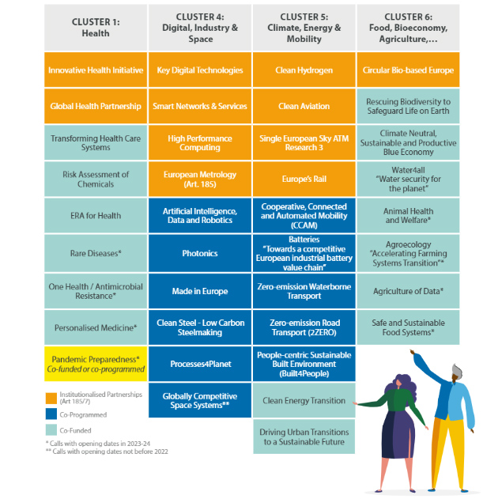
PARTNERSHIPS IN HE
CAN WE COMPARE THEM WITH JOINT ACTIONS?

Slide 33
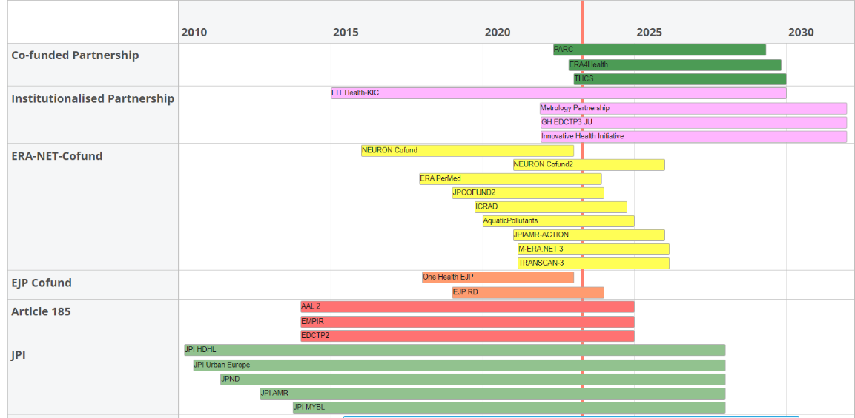
Paartherships: past/present/future

Slide 34

EU PARTNERSHIP |HEALTH
Draft proposals of the candidates for European Partnerships in Health:
https://ec.europa.eu/info/horizon-europe/european-partnerships-horizon-europe/candidates-european-partnerships-health_en
Institutionalized Partnerships:
  Innovative Health Initiative (2021) (ex-IMI2)
  European Partnership for EU-Africa Global Health (2021) (ex-EDCTP2)
Co-funded Partnerships:
  European Partnership for the Assessment of Risks from Chemicals (PARC) (2021)
  European Partnership Fostering an ERA for Health research (2022)
  European Partnership on Transforming Health and Care Systems (2022)
  European Partnership for Personalised Medicine (2023)
  European Partnership on Rare Diseases (2024)
  European Partnership for One Health/AMR Antimicrobial Resistance (AMR) (2024/25)

Slide 35
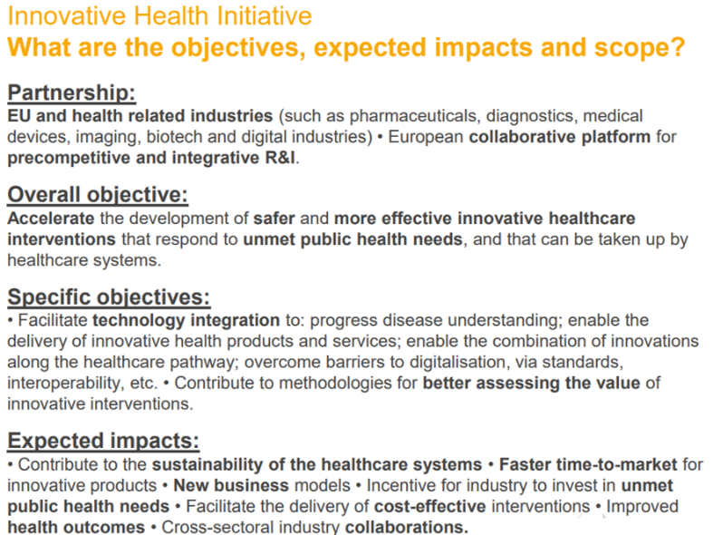

https://www.ihi.europa.eu

Slide 36

IHI – EU PPP Partnership
IHI call 3 (single stage call) Publication: 13 December 2022 | Deadline: 15 March 2023
Topic 1: Screening platform and biomarkers for prediction and prevention of diseases of unmet public health need
Topic 2: Patient generated evidence to improve outcomes, support decision making, and accelerate innovation
Topic 3: Combining hospital interventional approaches to improve patient outcomes and increase hospital efficiencies
Topic 4: Strengthening the European ecosystem for Advanced Therapy Medicinal Products (ATMPs) and other innovative therapeutic modalities for rare diseases
Topic 5: Digital health technologies for the prevention and personalised management of mental disorders and their long-term health consequences
IHI call 4 (two stage call) Publication: 17 January 2023
Topic 1: Expanding translational knowledge in minipigs: a path to reduce and replace non-human primates in non-clinical drug safety assessment
Topic 2: Patient-centric blood sample collection to enable decentralised clinical trials and improve access to healthcare

Slide 37
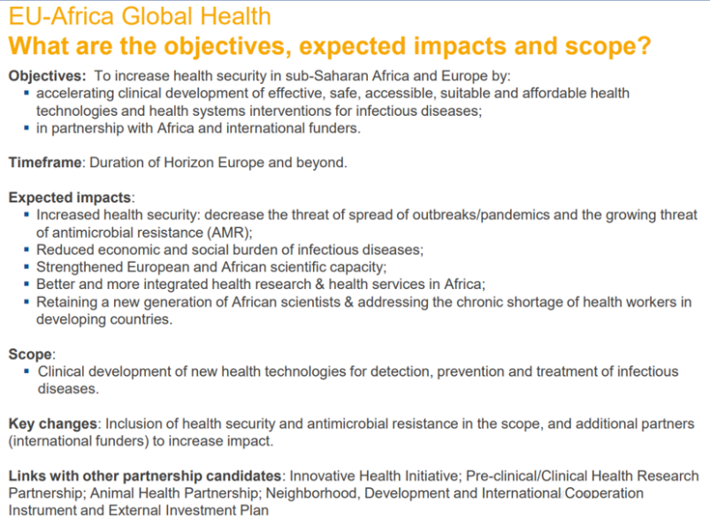

https://www.edctp.org/

Slide 38
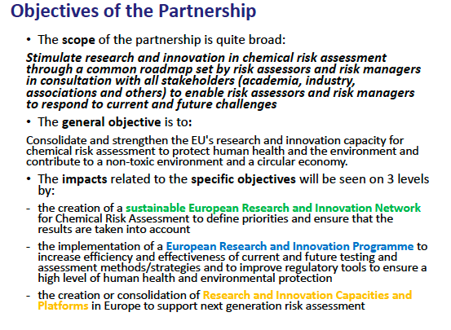

https://www.eu-parc.eu/

Slide 39
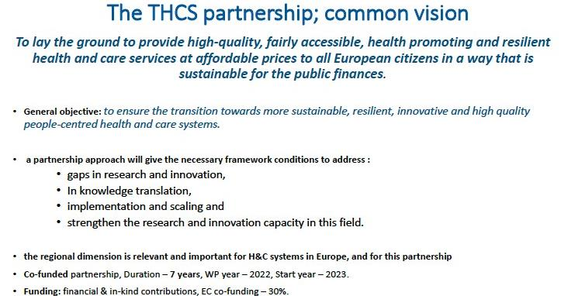
https://www.thcspartnership.eu/

Slide 40

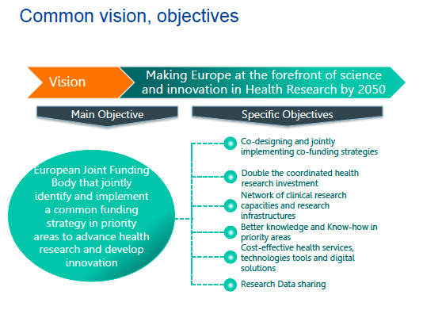
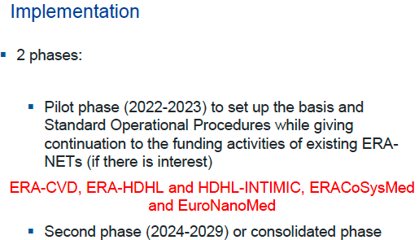
https://era4health.eu/

Slide 41
European Partnership for Personalised Medicine
The partnership aims to coordinate research in personalized medicine between the EU, EU countries and regions.
Aims:
faster uptake of research and innovation results into clinical practice, secure Europe's position in state-of-the-art healthcare provision.
facilitate a shift from a ‘one size fits all’ approach towards taking into account individual differences and better utilizing the accumulating data to manage health, disease and its predisposition.
sustainable health systems and independence in data intensive healthcare.
Under preparation! 2023

Slide 42
European Partnership on Rare Diseases
The partnership will coordinate national, local and European research and innovation programmes, combining research funding and implementation of research supportive activities such as training, data access infrastructures, data standards etc.
The main goal is to improve the life of patients with rare diseases by developing diagnostics and treatments for rare diseases through multidisciplinary research and innovation programmes with all relevant stakeholders. This will increase impact and uptake of research results as well as increase the visibility of EU leadership in rare diseases research.
Under preparation! 2023

Slide 43
European Partnership for One Health/AMR Antimicrobial Resistance (AMR)
The partnership aims to coordinate and align activities and funding between countries as well as with the Commission. It will also facilitate national coherence between different services and ministries with responsibility for the various aspects of AMR (e.g. human health, agriculture, environment, industry, finances).
The main goal is to contribute to achieving the objectives of the European One Health Action Plan against AMR and the WHO Global Action Plan on AMR, by reducing the threat of AMR.
Under preparation! 2024

Slide 44

MISSIONS

Slide 45

MISSIONS
Mission means a portfolio of excellence-based and impact-driven R&I actions across disciplines and sectors, intended to:
achieve, within a set timeframe, a measurable goal that could not be achieved through individual actions
have impact on society and policy-making through science and technology
be relevant for a significant part of the European population and a wide range of European citizens

Slide 46





Adaptation to climate change, including societal transformation
Cluster 5, Cluster 2
Healthy oceans,
seas, coastal and inland
waters
Cluster 6
Cluster 1
Mission areas
Cancer
Cluster 5
Climate-neutral
and smart cities
Soil health and food
Cluster 6

Slide 47

MISSION – BUDGET
There is no fixed budget for each mission
During the first three years of the programme, a maximum of 10% of the annual budget of Pillar II shall be programmed through specific calls for implementing the missions
For the remaining part of the programme, and only after a positive assessment of the mission selection and management process, this percentage may be increased

Slide 48

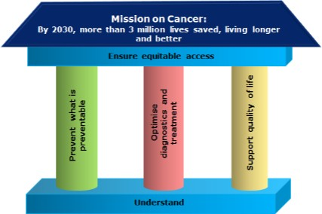
MISSION CANCER
Conquering Cancer: Mission Possible
Targets by 2030: more than 3 million lives saved, living longer and better: achieve a thorough understanding of cancer, prevent what is preventable, optimize diagnosis and treatment, support the quality of life of all people exposed to cancer, and ensure equitable access to the above across Europe.
13 recommendations
Aggiornata la pagina delle Mission sul sito della Commissione: https://ec.europa.eu/info/horizon-europe/missions-horizon-europe_en
  Nomine dei mission managers e dei vice: https://ec.europa.eu/info/horizon-europe/missions-horizon-europe_en
  Schede per la valutazione dei piani d’implementazione, che dovrebbero essere presentati a giugno: https://ec.europa.eu/info/horizon-europe/missions-horizon-europe/assessment-criteria_en

Slide 49
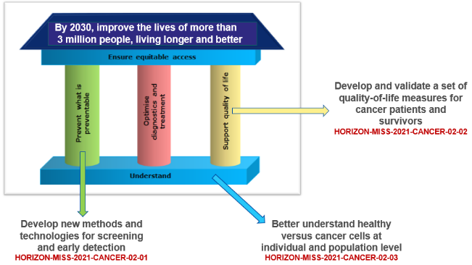
HORIZON-MISS-2021-CANCER-02-01: Develop new methods and technologies for screening and early detection (RIA)
HORIZON-MISS-2021-CANCER-02-02: Develop and validate a set of quality-of-life measures for cancer patients and survivors (RIA)
HORIZON-MISS-2021-CANCER-02-03: Better understand healthy versus cancer cells at individual and population level (RIA)
Mission on Cancer: topics in 2021 as an example
Opening: 22 Dec 2021
Deadline(s): 26 Apr 2022

Slide 50




Matchmaking events on Cluster 1 Health
PAST:
19 Gennaio 2023 (virtuale): Infoday WP CL1 2023-2024
20 Gennaio 2023 (virtuale): International Brokerage Event CL1
https://research-and-innovation.ec.europa.eu/events/horizon-europe-info-days/cluster-1_en
Upcoming:
1° of June 2023: EC Infoday on topics 2024
2° of June 2023: Brokerage event on topics 2024
5° of June 2023: Paris, onsite Brokerage event on SSH and Health

Slide 51

Horizon Europe - Keep informed & Get involved
HorizonEU
Register to receive the latest updates of developments
Reach out to National Contact Points Search by country and contact your NCP through the F&T portal ! https://ec.europa.eu/info/fundingtenders/opportunities/portal/screen/support/ncp
Become an independent evaluator for HE proposals
  →ALL this can be done via EC portal for Funding & Tenders Opportunities.
  https://ec.europa.eu/info/funding-tenders/opportunities/portal
Horizon Europe Work Programmes (link) and Programme Guide (link)
Horizon Europe website: http://ec.europa.eu/horizon-europe
EU-funded Health Research and Innovation: https://ec.europa.eu/info/research-and-innovation/research-area/health-research-and-innovation_en
51

Slide 52
Useful Links
Regulation establishing Horizon Europe
https://data.consilium.europa.eu/doc/document/ST-7064-2020-INIT/it/pdf
Corporate Model Grant Agreement
https://ec.europa.eu/transparency/regdoc/rep/3/2020/EN/C-2020-3759-F1-EN-ANNEX-1-PART-1.PDF
Horizon Europe MGA
https://ec.europa.eu/info/funding-tenders/opportunities/docs/2021-2027/common/agr-contr/general-mga_horizon-euratom_en.pdf
General Annexes Main WP
https://ec.europa.eu/info/funding-tenders/opportunities/docs/2021-2027/horizon/wp-call/2021-2022/wp-13-general-annexes_horizon-2021-2022_en.pdf

Slide 53


THANK YOU!
Email:cluster1@apre.it
Tel. +39 06 48 93 9993
www.apre.it

