Slide 1



JA NFP4Health NFP Profile – How to draft a successful EU4Health proposal
WEBINAR
11.07.2023
This presentation is part of the action “NFP4Health”
which has received funding from the European Union’s Health
Programme (2014-2020) under grant agreement No 101035965.

Slide 2
Presentation of new EU4Health Open Calls
This presentation is part of the action “NFP4Health”
which has received funding from the European Union’s Health
Programme (2014-2020) under grant agreement No 101035965.

Slide 3
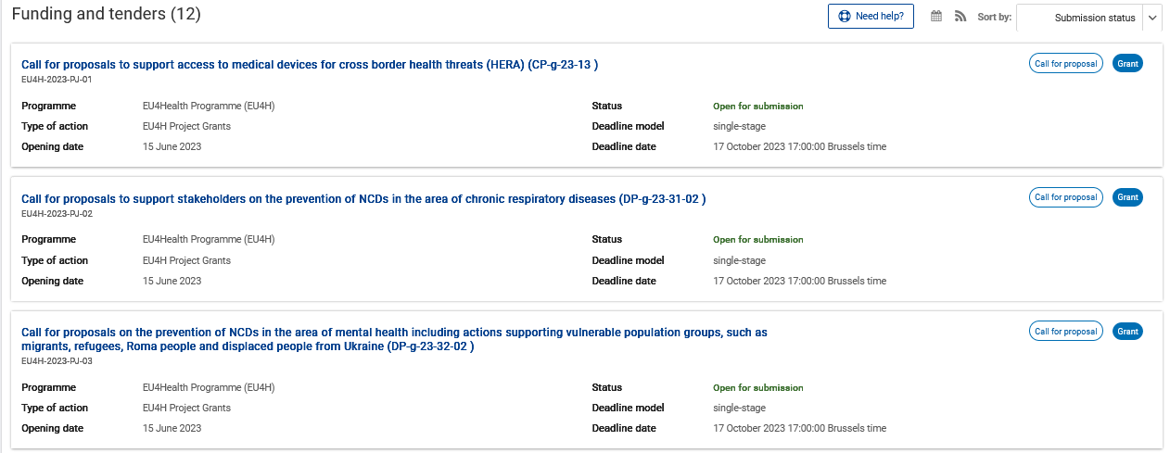
New EU4Health Open Calls - DEADLINE 17.10.2023
LINK EU FUNDING&TENDERS PORTAL
This presentation is part of the action “NFP4Health”
which has received funding from the European Union’s Health
Programme (2014-2020) under grant agreement No 101035965.

Slide 4
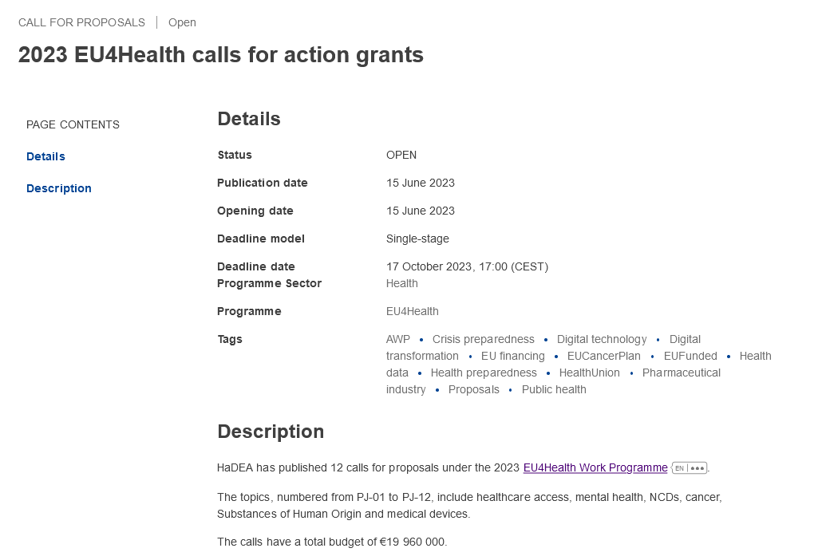
New EU4Health Open Calls - DEADLINE 17.10.2023
LINK HaDEA
This presentation is part of the action “NFP4Health”
which has received funding from the European Union’s Health
Programme (2014-2020) under grant agreement No 101035965.

Slide 5
Eligibility Requirements
SPECIAL REQUIREMENTS EXAMPLE (to be checked in each call)
Type of applicants | Scientific societies, academia, health authorities/institutions and NGOs, possibly also including SMEs active and with expertise in the area of the action.
Specific eligibility and selection criteria applicable to the consortium composition | Proposals must be submitted by a consortium of at least 3 applicants (beneficiaries; not affiliated entities), which complies with the following conditions: minimum 3 entities from 3 different eligible countries.
LINK EU FUNDING&TENDERS PORTAL
This presentation is part of the action “NFP4Health”
which has received funding from the European Union’s Health
Programme (2014-2020) under grant agreement No 101035965.

Slide 6

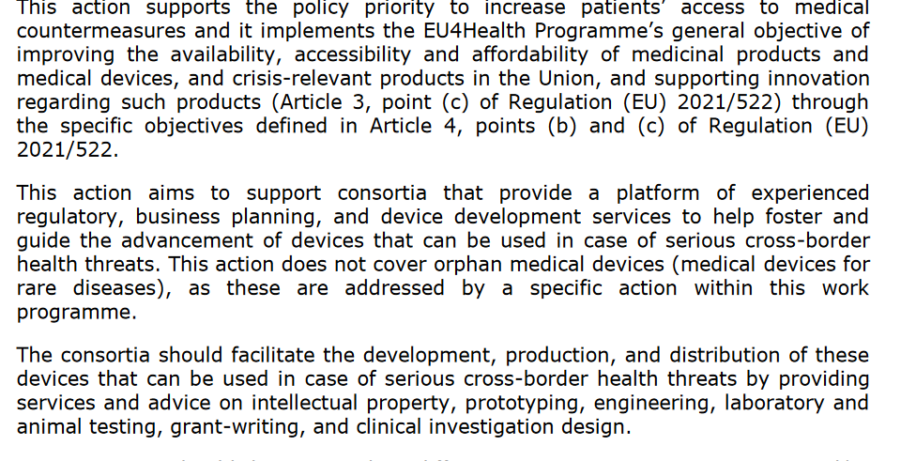

EU4H-2023-PJ-01 Call for proposals to support access to medical devices for cross border health threats (HERA) (CP-g-23-13)
This presentation is part of the action “NFP4Health”
which has received funding from the European Union’s Health
Programme (2014-2020) under grant agreement No 101035965.

Slide 7
EU4H-2023-PJ-01 Call for proposals to support access to medical devices for cross border health threats (HERA) (CP-g-23-13)
ACTIVITIES
promoting capacity building and knowledge sharing including by providing capabilities for promising devices.
establishing connections between individuals and/or entities (e.g., where there is potential for knowledge sharing, joint development, etc.);
mentoring projects through the development process;
realistically assessing the scientific, engineering, pre-clinical and clinical innovation potential of the medical devices and adequately guide projects through the best regulatory pathway;
supporting in finding funding/investment sources, and assessing market opportunities in order to ensure successful prototyping, development, manufacturing and marketing of promising devices;
and providing business, legal (including intellectual property) and regulatory (and other necessary) support at the stage of submission for conformity assessment.
This presentation is part of the action “NFP4Health”
which has received funding from the European Union’s Health
Programme (2014-2020) under grant agreement No 101035965.

Slide 8

EU4H-2023-PJ-02 — Call for proposals to support stakeholders on the prevention of NCDs in the area of chronic respiratory diseases (DP-g-23-31-02)
The aim of this action is to complement the activities of the joint action “DP-g-23-31-01 ‘Healthier Together’ EU NCD Initiative – Chronic respiratory diseases” led by the Member States, thus helping to reduce the burden of CRDs in the Union, both at personal and population level, targeting or addressing the related risk factors and their determinants, as necessary.
This presentation is part of the action “NFP4Health”
which has received funding from the European Union’s Health
Programme (2014-2020) under grant agreement No 101035965.

Slide 9
EU4H-2023-PJ-02 — Call for proposals to support stakeholders on the prevention of NCDs in the area of chronic respiratory diseases (DP-g-23-31-02)
ACTIVITIES
Implementation of public health policies
Development and transfer of best practices
Development of public health guidelines
Preparation and roll-out of innovative approaches
Projects supporting patient pathways
Projects supporting Member States (Zero Pollution Action Plan, Chemicals Strategy for Sustainability, Europe’s Beating Cancer Plan)
This presentation is part of the action “NFP4Health”
which has received funding from the European Union’s Health
Programme (2014-2020) under grant agreement No 101035965.

Slide 10
EU4H-2023-PJ-03 — Call for proposals on the prevention of NCDs in the area of mental health including actions supporting vulnerable population groups, such as migrants, refugees, Roma people and displaced people from Ukraine (DP-g-23-32-02)
The aim of this action is to complement the implementation of the joint action “DP-g-23-32- 01 ‘Healthier Together’ EU NCD Initiative – Mental Health” led by the Member States, thus helping to promote mental health, and to reduce the burden of mental health problems in the Union, both at individual and population level, targeting or addressing the related risk factors and their determinants, as necessary.
Consortium: minimum 3 entities from 3 different eligible countries; at least one NGO & one patient organisation working in area of mental health.
This presentation is part of the action “NFP4Health”
which has received funding from the European Union’s Health
Programme (2014-2020) under grant agreement No 101035965.

Slide 11

EU4H-2023-PJ-03 — Call for proposals on the prevention of NCDs in the area of mental health including actions supporting vulnerable population groups, such as migrants, refugees, Roma people and displaced people from Ukraine (DP-g-23-32-02)
ACTIVITIES
Implementation of public health policies related to mental health
Development and transfer of best practices
Development of public health guidelines
Preparation and roll-out of innovative approaches
Projects supporting patient pathways
Targeted projects to support vulnerable groups (migrants, refugees, Roma people, displaced people from Ukraine)
This presentation is part of the action “NFP4Health”
which has received funding from the European Union’s Health
Programme (2014-2020) under grant agreement No 101035965.

Slide 12

EU4H-2023-PJ-04 — Call for proposals on prevention of NCDs in the area of dementia and other neurological disorders (DP-g-23-33-02)
The aim of this action is to complement the implementation of the joint action “DP-g-23-33- 01 ‘Healthier Together’ EU NCD Initiative – Dementia and neurological disorders” led by the Member States, thus helping to reduce the burden of dementia and other neurological disorders in the Union, both at personal and population level, targeting or addressing the related risk factors and their determinants, as necessary.
This presentation is part of the action “NFP4Health”
which has received funding from the European Union’s Health
Programme (2014-2020) under grant agreement No 101035965.

Slide 13
EU4H-2023-PJ-04 — Call for proposals on prevention of NCDs in the area of dementia and other neurological disorders (DP-g-23-33-02)
ACTIVITIES
Implementation of public health policies
Development and transfer of best practices
Development of public health guidelines
Preparation and roll-out of innovative approaches
Projects supporting patient pathways
Projects targeting the prevention or care of dementia/neurological disorders
This presentation is part of the action “NFP4Health”
which has received funding from the European Union’s Health
Programme (2014-2020) under grant agreement No 101035965.

Slide 14
EU4H-2023-PJ-05 — Call for proposals to support the implementation of the strategic agenda for medical ionising radiation applications (SAMIRA18) – organisation of clinical audit campaigns as a tool to improve quality and safety of medical applications of ionising radiation (CR-g-23-44-01)
Pilot clinical audit campaigns in Member States in diagnostic and interventional radiology, radiotherapy and nuclear medicine by identifying and bringing together relevant actors and resources.
Campaigns should be implemented in coordination with the health authorities and take into account the specificities of national health systems.
Campaigns should seek to improve justification of radiological imaging and the implementation of the optimisation principle.
Proposals should include considerations and activities to scale-up pilot outcomes into the broader health system practice of MS.
This presentation is part of the action “NFP4Health”
which has received funding from the European Union’s Health
Programme (2014-2020) under grant agreement No 101035965.

Slide 15
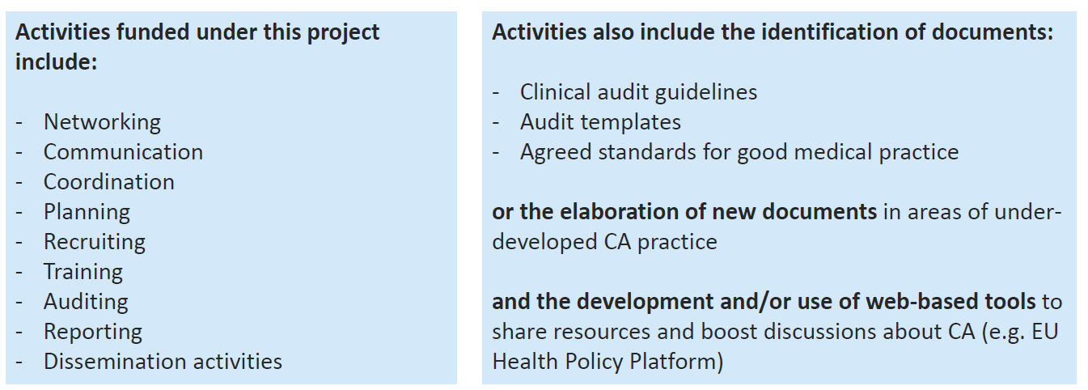
EU4H-2023-PJ-05 — Call for proposals to support the implementation of the strategic agenda for medical ionising radiation applications (SAMIRA18) – organisation of clinical audit campaigns as a tool to improve quality and safety of medical applications of ionising radiation (CR-g-23-44-01)
This presentation is part of the action “NFP4Health”
which has received funding from the European Union’s Health
Programme (2014-2020) under grant agreement No 101035965.

Slide 16
EU4H-2023-PJ-06 — Call for proposals: action grants on mental health challenges for cancer patients and survivors Sub-topic (a): Mental health and Cancer (CR-g-23-19.01)
This action aims to address mental health challenges in cancer patients and survivors, and their carers and families.
Consortium: minimum 3 entities from 3 different eligible countries; at least one NGO & one patient organisation working in field of cancer or mental health.
This presentation is part of the action “NFP4Health”
which has received funding from the European Union’s Health
Programme (2014-2020) under grant agreement No 101035965.

Slide 17
EU4H-2023-PJ-06 — Call for proposals: action grants on mental health challenges for cancer patients and survivors Sub-topic (a): Mental health and Cancer (CR-g-23-19.01)
ACTIVITIES
Systematic screening of mental health status of cancer patients, carers and families
Development of methodologies to support identification of at-risk patients, carers and families
Provision of psychological and psychosocial support and targeted interventions
Development of guidance and recommendations for professionals (patient care pathway)
Provision of professional psychosocial support for children, adolescents and young adults with cancer
This presentation is part of the action “NFP4Health”
which has received funding from the European Union’s Health
Programme (2014-2020) under grant agreement No 101035965.

Slide 18
EU4H-2023-PJ-07 — Call for proposals: action grants on mental health challenges for cancer patients and survivors Sub-topic (b): European Code for Mental Health (CR-g-23-19.02)
This action aims to address mental health challenges in cancer patients and survivors, and their carers and families.
Consortium: Minimum 5 entities (beneficiaries) from 5 different eligible countries + at least one NGO working in the field of mental health + at least one patient organization working in the field of mental health + at least one public authority responsible for mental health
This presentation is part of the action “NFP4Health”
which has received funding from the European Union’s Health
Programme (2014-2020) under grant agreement No 101035965.

Slide 19
EU4H-2023-PJ-07 — Call for proposals: action grants on mental health challenges for cancer patients and survivors Sub-topic (b): European Code for Mental Health (CR-g-23-19.02)
ACTIVITIES
Development of a European Code for Mental Health
Messages that are evidence-based, easy-to-understand and easy-to-implement for citizens
How citizens can take care of their own mental health and their families’
Reduce risk of mental health problems
This presentation is part of the action “NFP4Health”
which has received funding from the European Union’s Health
Programme (2014-2020) under grant agreement No 101035965.

Slide 20
EU4H-2023-PJ-08 — Call for proposals: action grants on the safety and quality of new Substances of Human Origin (Breast milk, faecal microbiota transplants) (a) HS-g-23-50.01 Breast milk (HS-g-23-50.01)
&
EU4H-2023-PJ-09 — Call for proposals: action grants on the safety and quality of new Substances of Human Origin (Breast milk, faecal microbiota transplants) (b) HS-g-23-50.02 Faecal microbiotic transplants (HS-g-23-50.02)
This action aims to bring together sector professionals, for BM (topic (a)) and for FMT (topic (b)), and to facilitate the implementation of new SoHO Regulation (guidelines and legislative requirements as well as the compliance with oversight tasks), in order to allow the safe, effective and qualitative preparation and use of these SoHO-based therapies.
This presentation is part of the action “NFP4Health”
which has received funding from the European Union’s Health
Programme (2014-2020) under grant agreement No 101035965.

Slide 21
EU4H-2023-PJ-08 — Call for proposals: action grants on the safety and quality of new Substances of Human Origin (Breast milk, faecal microbiota transplants) (a) HS-g-23-50.01 Breast milk (HS-g-23-50.01)
&
EU4H-2023-PJ-09 — Call for proposals: action grants on the safety and quality of new Substances of Human Origin (Breast milk, faecal microbiota transplants) (b) HS-g-23-50.02 Faecal microbiotic transplants (HS-g-23-50.02)
ACTIVITIES
Building an expert forum of actors in breast milk and stool banking;
Developing common set of draft guidelines based on expertise and existing initiatives -from professional societies, research and publications (Keller&all(FMT), EMBA (BM), EDQM (BM/FMT), … );
Future updating of guidelines with/under new EU legislative work;
Implementation plan (technical guidelines + oversight provisions);
Training and dissemination
Taking account of commonalities and specificities of BM and FMT with other
This presentation is part of the action “NFP4Health”
which has received funding from the European Union’s Health
Programme (2014-2020) under grant agreement No 101035965.

Slide 22
EU4H-2023-PJ-10 — Call for Proposals: action grants on Facilitating Organ Paired Exchange (HS-g-23-51)
This action implements the EU4Health Programme’s general objective of improving the availability, accessibility and affordability of medicinal products and medical devices, and crisis-relevant products in the Union, and supporting innovation regarding such products (Article 3, point (c) of Regulation (EU) 2021/522) through the specific objectives defined in Article 4, points (c) and (h), of Regulation (EU) 2021/522.
This action will apply the common algorithm for matching donor-patient pairs, among the participants and will develop its application.
This presentation is part of the action “NFP4Health”
which has received funding from the European Union’s Health
Programme (2014-2020) under grant agreement No 101035965.

Slide 23
EU4H-2023-PJ-10 — Call for Proposals: action grants on Facilitating Organ Paired Exchange (HS-g-23-51)
ACTIVITIES
This action will apply the common algorithm for matching donor-patient pairs, among the participants and will develop its application by:
developing the modalities for participating to the exchange schemes, including agreement and uptake by the different national allocation offices;
feeding the algorithm with harmonized pair data via a common IT platform between participants;
developing common support protocols among participants, covering all related aspects like oversight, governance, funding, follow-up of donors and patients, in order to allow that transplantations are taking place.
roll out a common approach across national competent authorities, in charge of organ allocation.
This presentation is part of the action “NFP4Health”
which has received funding from the European Union’s Health
Programme (2014-2020) under grant agreement No 101035965.

Slide 24

EU4H-2023-PJ-11 — Call for proposals for a program on orphan medical devices, in particular targeting paediatric patients (HS-g-23-65)
This action aims to support non-profit organisations or consortia that provide a platform for academic bodies, scientific societies, developer of devices, in particular SMEs, and NGOs with a specific interest in innovative paediatric devices to help foster and guide the development of orphan devices, for paediatric patients, in particular in areas of unmet medical needs.
It takes inspiration from the Paediatric Device Consortia Grants Program of the US Food and Drugs Administration (FDA).
This presentation is part of the action “NFP4Health”
which has received funding from the European Union’s Health
Programme (2014-2020) under grant agreement No 101035965.

Slide 25
EU4H-2023-PJ-11 — Call for proposals for a program on orphan medical devices, in particular targeting paediatric patients (HS-g-23-65)
ACTIVITIES
The activities may include intellectual property advising; prototyping; engineering; laboratory and animal testing; grant-writing; and clinical investigation design. The eligible entities should facilitate the development, production, and distribution of orphan devices, in particular for paediatric patients by:
a) encouraging innovation and connecting relevant players (e.g. academia, scientific societies, users) with orphan device ideas with potential manufacturers;
b) mentoring and managing orphan device projects through the development process, including product identification, prototype design, device development, and marketing;
c) connecting developers of innovative devices and physicians to existing financing resources;
d) assessing the scientific and medical merit of proposed orphan device projects;
e) providing assistance and advice as needed on business development, personnel training, prototype development, and post-marketing needs; and
f) providing regulatory consultation to device developers in support of achieving CE marking for the orphan device.
This presentation is part of the action “NFP4Health”
which has received funding from the European Union’s Health
Programme (2014-2020) under grant agreement No 101035965.

Slide 26

EU4H-2023-PJ-12 — Call for proposal: action grants to contribute to the organisations of conference and events (OA-g-23-89)
To support the organisation of not-for-profit, EU-wide high-level science-policy-society events that bring together all interested parties such as citizens, patients, practitioners, academics and scientists, policy makers from local, regional, and EU level.
The events will promote and contribute to the development and implementation of the European Health Union touching in a comprehensive way the most salient health issues and EU health priorities.
This presentation is part of the action “NFP4Health”
which has received funding from the European Union’s Health
Programme (2014-2020) under grant agreement No 101035965.

Slide 27
EU4H-2023-PJ-12 — Call for proposal: action grants to contribute to the organisations of conference and events (OA-g-23-89)
ACTIVITIES
The proposals should include at least one of following activities:
a) effective mobilisation of a broad audience with participation of policy makers (EU, national, regional and where necessary global levels), academia, industry, civil society including patients’ organisations and other relevant representative);
b) provide a platform for a sounding board to explain EU health initiatives and health societal challenges;
c) sustainable outreach activities beyond the event with multiplier effect including on social media;
d) facilitate high-level policy dialogues attracting relevant health actors from different relevant sectors;
e) the use of innovative approaches in running the event are a plus.
Priority will be given to proposals covering several of the above activities.
This presentation is part of the action “NFP4Health”
which has received funding from the European Union’s Health
Programme (2014-2020) under grant agreement No 101035965.

Slide 28
How to draft a successful
EU4Health proposal
This presentation is part of the action “NFP4Health”
which has received funding from the European Union’s Health
Programme (2014-2020) under grant agreement No 101035965.

Slide 29

Look for the right call
First of all you have to check the right call for your project idea:
Funding and Tender Opportunities Portal
HaDEA webpage: https://hadea.ec.europa.eu/calls-proposals_en
This presentation is part of the action “NFP4Health”
which has received funding from the European Union’s Health
Programme (2014-2020) under grant agreement No 101035965.

Slide 30
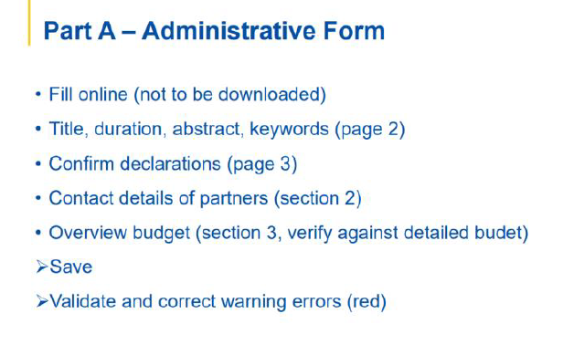
Part A – Administrative Form
Complete Part A of the Administrative Form directly online on the portal with:
the title and acronym of the project, abstract keywords,
contact details of the various partners, any declarations to be signed,
the overall budget.
It will be possible to save everything while filling in and validate to confirm any errors to be corrected.
This presentation is part of the action “NFP4Health”
which has received funding from the European Union’s Health
Programme (2014-2020) under grant agreement No 101035965.

Slide 31
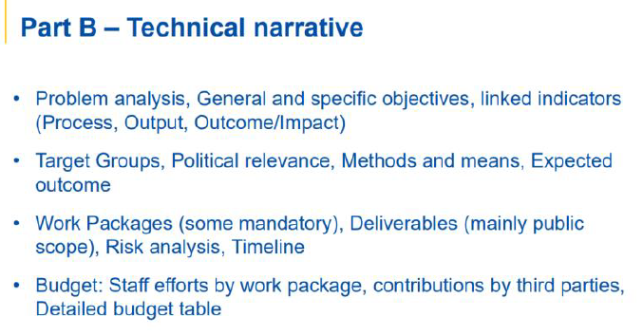
Part B – Project Proposal
Part B is the descriptive part, relating to the actual project proposal with:
the problem to solve,
the general and specific objectives, expected results and indicators,
the target groups,
socio-economic, political, environmental impact,
the methodologies applied,
a detailed work plan, with a description of the activities,
roles of the various partners, deliverables, milestones,
risk analysis,
GANTT.
budget (workload per work package, details of expected costs, etc.).
This presentation is part of the action “NFP4Health”
which has received funding from the European Union’s Health
Programme (2014-2020) under grant agreement No 101035965.

Slide 32
EU Funding&Tenders Portal
This presentation is part of the action “NFP4Health”
which has received funding from the European Union’s Health
Programme (2014-2020) under grant agreement No 101035965.

Slide 33
EU Funding&Tenders Portal
This presentation is part of the action “NFP4Health”
which has received funding from the European Union’s Health
Programme (2014-2020) under grant agreement No 101035965.

Slide 34
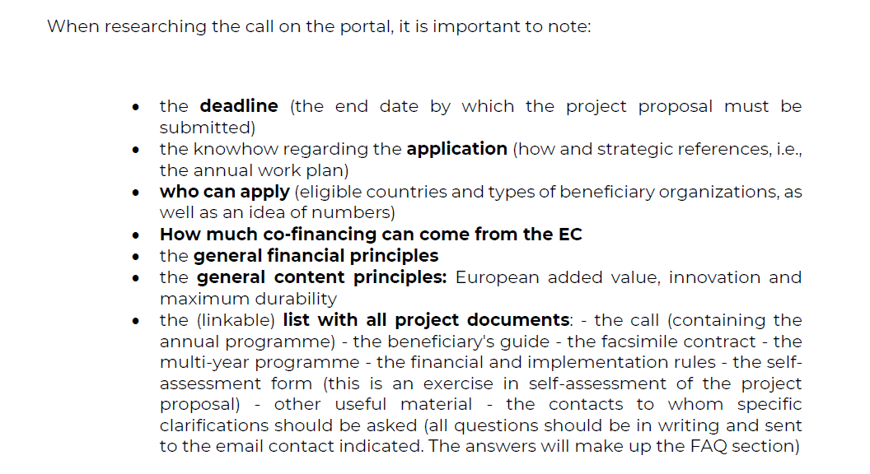
EU Funding&Tenders Portal
This presentation is part of the action “NFP4Health”
which has received funding from the European Union’s Health
Programme (2014-2020) under grant agreement No 101035965.

Slide 35
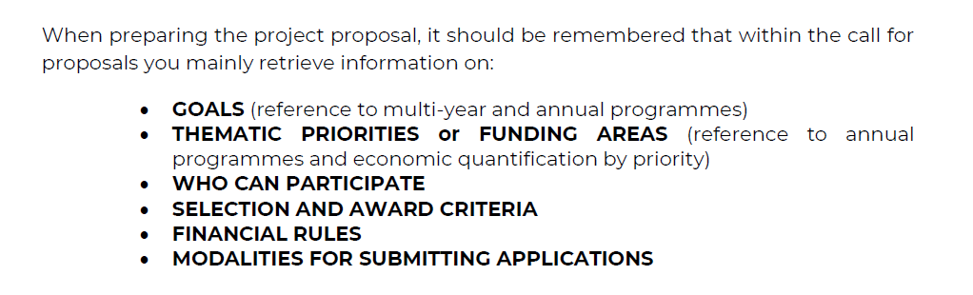

Checking List for the Project Proposal
This presentation is part of the action “NFP4Health”
which has received funding from the European Union’s Health
Programme (2014-2020) under grant agreement No 101035965.

Slide 36
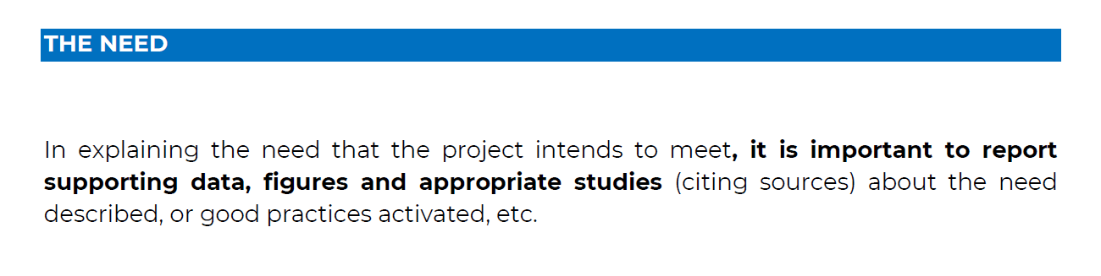

How to define the need of the project proposal
This presentation is part of the action “NFP4Health”
which has received funding from the European Union’s Health
Programme (2014-2020) under grant agreement No 101035965.

Slide 37
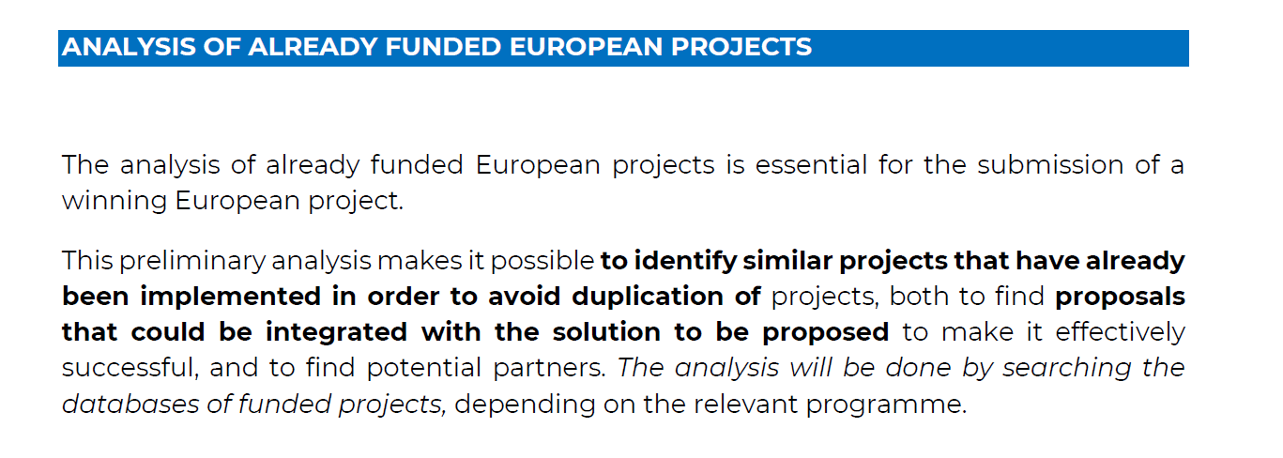
Check the EU projects already funded
This presentation is part of the action “NFP4Health”
which has received funding from the European Union’s Health
Programme (2014-2020) under grant agreement No 101035965.

Slide 38
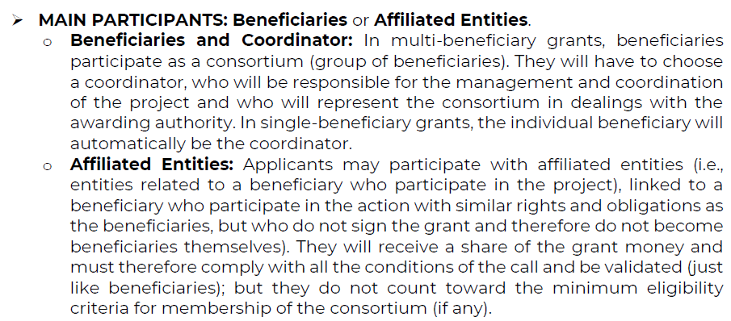

How to build the Consortium
This presentation is part of the action “NFP4Health”
which has received funding from the European Union’s Health
Programme (2014-2020) under grant agreement No 101035965.

Slide 39
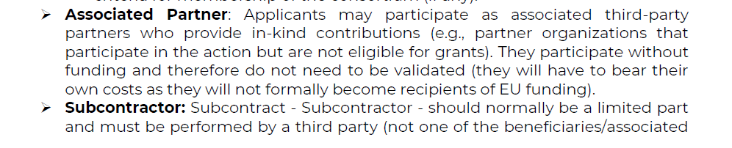
How to build the Consortium
This presentation is part of the action “NFP4Health”
which has received funding from the European Union’s Health
Programme (2014-2020) under grant agreement No 101035965.

Slide 40
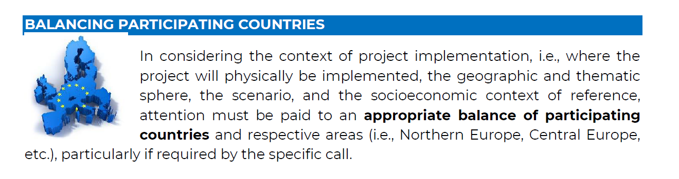
How to build the Consortium
This presentation is part of the action “NFP4Health”
which has received funding from the European Union’s Health
Programme (2014-2020) under grant agreement No 101035965.

Slide 41

How to design a project
In order to carry out a project design always starts from the "creative" phase (the idea), so it is essential to fully understand the context of reference, clarify the scenario, needs and/or problems that you want to respond to with the project to be implemented.
It is also important to follow the parameters made explicit in the call - policy context - as these aspects will be considered in the evaluation phase.
In the following slides there are some design tools.
This presentation is part of the action “NFP4Health”
which has received funding from the European Union’s Health
Programme (2014-2020) under grant agreement No 101035965.

Slide 42
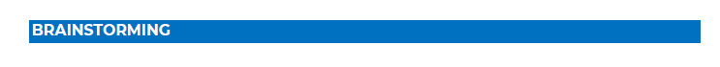

How to design a project
Brainstorming is a method that aims to develop creative solutions to problems.
The goal of brainstorming is the production of "possible solutions for a specific scenario." Underlying this is the idea of play, as a light-hearted dimension that allows the creativity of individuals and the group to be unleashed, and which is normally prevented by a series of inhibitions. The ideal group of participants should be no more than about 15 people.
Indeed, the goal is to produce new ideas, while judgment introduces an element of restraint and induces defensive attitudes. Initial brainstorming ideas are then refined and reworked, deepened and revised by the group, referring to ideas proposed by other participants, so that initial ideas are transformed into increasingly practical and feasible proposals.
This presentation is part of the action “NFP4Health”
which has received funding from the European Union’s Health
Programme (2014-2020) under grant agreement No 101035965.

Slide 43
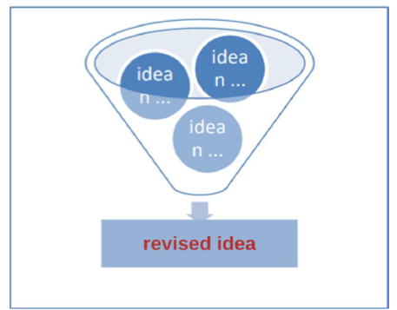
How to design a project
During brainstorming, it is useful for a facilitator to be present to manage the group dynamic by:
• proposing the initial scenario in a clear and simple way (the facilitator must have studied the relevant programme and call);
• reminding participants to suspend judgment and to focus on expressing ideas;
• not to be afraid of ideas that are considered disruptive and to welcome any ideas expressed;
• write down, on a whiteboard or similar, all the ideas expressed, so that they are visible to all and can be used for later elaboration;
• encourage participants to explore and elaborate on ideas expressed by others.
This presentation is part of the action “NFP4Health”
which has received funding from the European Union’s Health
Programme (2014-2020) under grant agreement No 101035965.

Slide 44
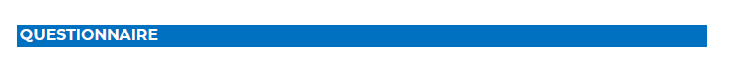

How to design a project
To detect the needs or demands of a certain context, that is, to ask stakeholders to express their opinions and expectations, the most immediate tool is the questionnaire.
Questionnaires can be a useful tool if they are well structured.
The processing of the questionnaires, as a synthesis of the insights, will lead to the definition of the project idea. This technique is cost-effective and it is often used to involve at an early stage international partners with whom we intend to work.
If you want to engage a larger, geographically dispersed group, you can use digital tools for conducting online questionnaires (Googleform, SurveyMonkey, etc.). These tools allow easy visualization of the responses collected for quantitative surveys (through graphs or other tools), facilitating their analysis and understanding.
This presentation is part of the action “NFP4Health”
which has received funding from the European Union’s Health
Programme (2014-2020) under grant agreement No 101035965.

Slide 45
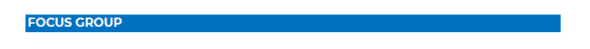

How to design a project
A focus group is a small group of people (usually 4 to 12) discussing a specific topic.
This technique is used when there is a need to focus (hence the name focus group) on a phenomenon or investigate a specific topic in depth, using the interaction that takes place among group members. It is important to select participants carefully so that they can contribute from different perspectives to the focus group.
Even for focus groups, it is useful to have a facilitator to organize the work and clarify and reiterate the goals of the work itself. The first thing to do is to clarify the goal: "to gather ideas and solutions in response to problems defined in the call.
This presentation is part of the action “NFP4Health”
which has received funding from the European Union’s Health
Programme (2014-2020) under grant agreement No 101035965.

Slide 46
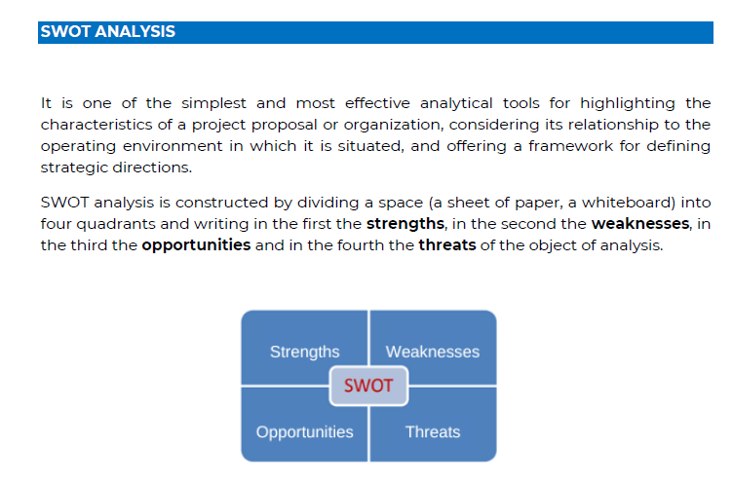
How to design a project
It is one of the simplest and most effective analytical tools for highlighting the characteristics of a project proposal or organization, considering its relationship to the operating environment in which it is situated, and offering a framework for defining strategic directions.
SWOT analysis is constructed by dividing a space (a sheet of paper, a whiteboard) into four quadrants and writing in the first the strengths, in the second the weaknesses, in the third the opportunities and in the fourth the threats of the object of analysis.
This presentation is part of the action “NFP4Health”
which has received funding from the European Union’s Health
Programme (2014-2020) under grant agreement No 101035965.

Slide 47
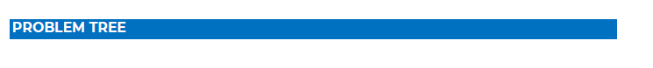
How to design a project
While the other methodologies belong to design in general, the problem tree is a popular methodology in European design and is sometimes required within the template.
With the help of all partners and beneficiaries (the latter whenever possible), problems and needs related to our project idea are identified. The problem tree represents the placement of identified problems in a cause-and-effect diagram (i.e., determining what causes what and what is caused by something else), represented vertically from bottom to top. The cause-and-effect links between different problems should be carefully checked as they form the basis of future design.
This presentation is part of the action “NFP4Health”
which has received funding from the European Union’s Health
Programme (2014-2020) under grant agreement No 101035965.

Slide 48
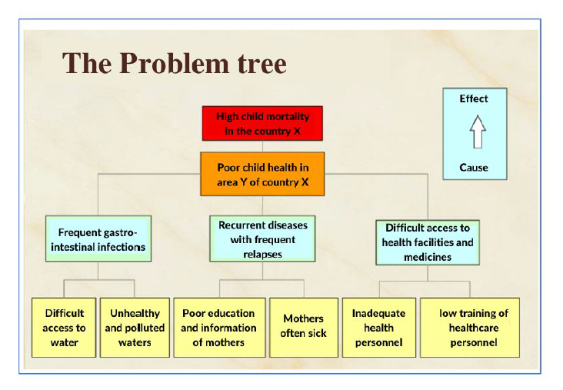
How to design a project
This presentation is part of the action “NFP4Health”
which has received funding from the European Union’s Health
Programme (2014-2020) under grant agreement No 101035965.

Slide 49
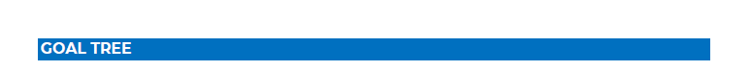
How to design a project
Through the construction of the problem tree, the problem/need situation at a given time is presented by clarifying the cause-effect relationships. Goal analysis starts from the problem tree to represent in a goal tree the expected future situation that would result from fully solving the problems detected and analyzed.
It represents the transformation of problems (current "negative" condition) into goals (desired future "positive" condition). If before we were dealing with cause-effect relationships, now we are thinking about the means to achieve the ends, the positive aspects.
This presentation is part of the action “NFP4Health”
which has received funding from the European Union’s Health
Programme (2014-2020) under grant agreement No 101035965.

Slide 50
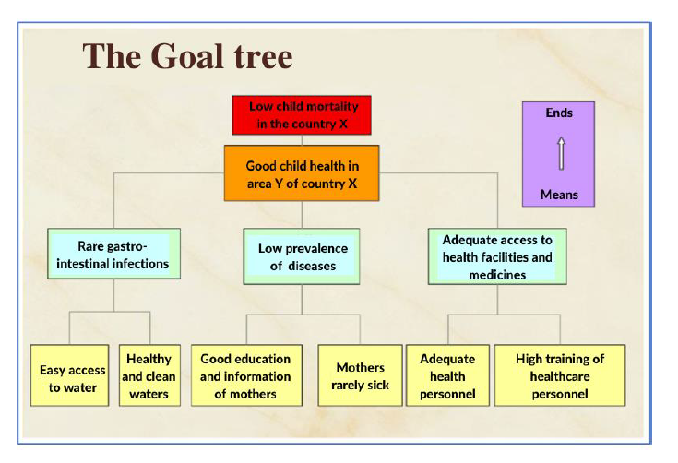
How to design a project
This presentation is part of the action “NFP4Health”
which has received funding from the European Union’s Health
Programme (2014-2020) under grant agreement No 101035965.

Slide 51
How to design a project
Once the tree is completed, a single focal problem is identified, which will be the purpose, also called the specific goal: the why of the project.
In developing the problem tree, you must:
• not express problems in a generic way such as "poor culture," "marginality" (it is convenient to describe the problem directly, without resorting to specialized terminology, this helps the analysis of possible causes and effects and promotes the identification of the resulting target);
• not run into so-called "absent solutions" (i.e. ask whether the alleged problem is hiding an implicit solution, usually expressed in terms of a lack, because it may actually represent an absent solution. If the goal obtained, by turning the presumed problem on its head, leads to identifying a different problem to the one from which it started, it means that the solution is still absent);
• check whether there are alternatives to the solution and whether the final beneficiaries really feel the problem is theirs.
This presentation is part of the action “NFP4Health”
which has received funding from the European Union’s Health
Programme (2014-2020) under grant agreement No 101035965.

Slide 52
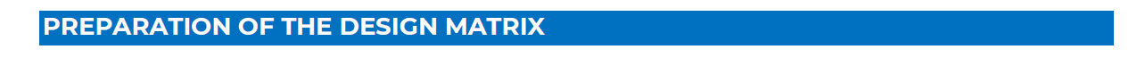
How to design a project
It is important to prepare a project matrix in order to identify:
a general goal (responds to the need you want to meet and is aligned with European policies/strategies),
specific goals (which refer to the priorities of the call),
expected outcomes, verification tools, implementation timeframe (while respecting the indications of the call),
economic and/or human resources defined (respecting the possibilities of expenditure of the call),
activities to be carried out (aligned with the specific goals to be achieved and which are sometimes "suggested" by the call),
methodology (it is important to refer to the "recognized-validated" models), intermediate and final evaluation (internal: monitoring of activities and verification of achievement of goals; external: evaluation of the project process and verification of impact in the target context),
communication and dissemination (current means of communication allow us to be really effective in building a communication plan: websites, newsletters, social networks, videos, etc.),
management (demonstrate the coordinator's leadership skills and past experience), ability to activate strong "shared" coordination with project partners (Coordination board). Some tools such as the "Logical Framework" can be used to build part of this matrix.
This presentation is part of the action “NFP4Health”
which has received funding from the European Union’s Health
Programme (2014-2020) under grant agreement No 101035965.

Slide 53
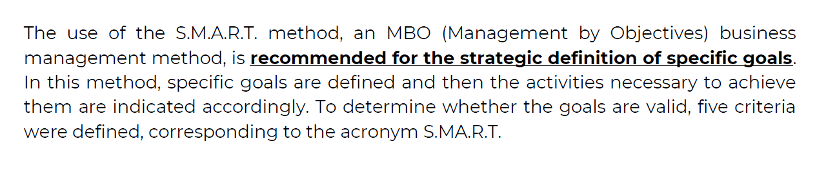

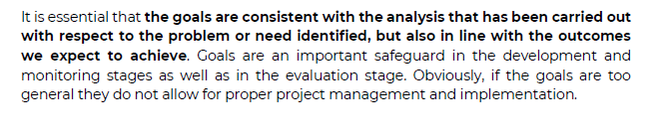
How to design a project
This presentation is part of the action “NFP4Health”
which has received funding from the European Union’s Health
Programme (2014-2020) under grant agreement No 101035965.

Slide 54
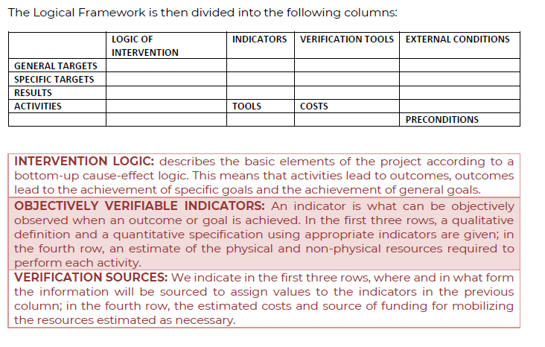
How to design a project
This presentation is part of the action “NFP4Health”
which has received funding from the European Union’s Health
Programme (2014-2020) under grant agreement No 101035965.

Slide 55
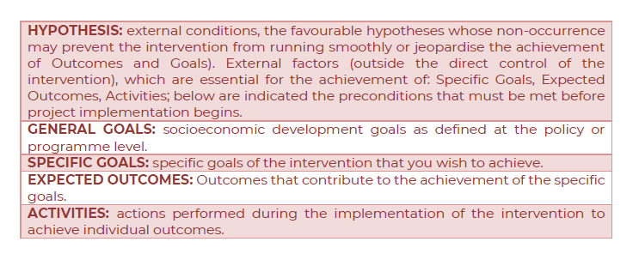
How to design a project
This presentation is part of the action “NFP4Health”
which has received funding from the European Union’s Health
Programme (2014-2020) under grant agreement No 101035965.

Slide 56
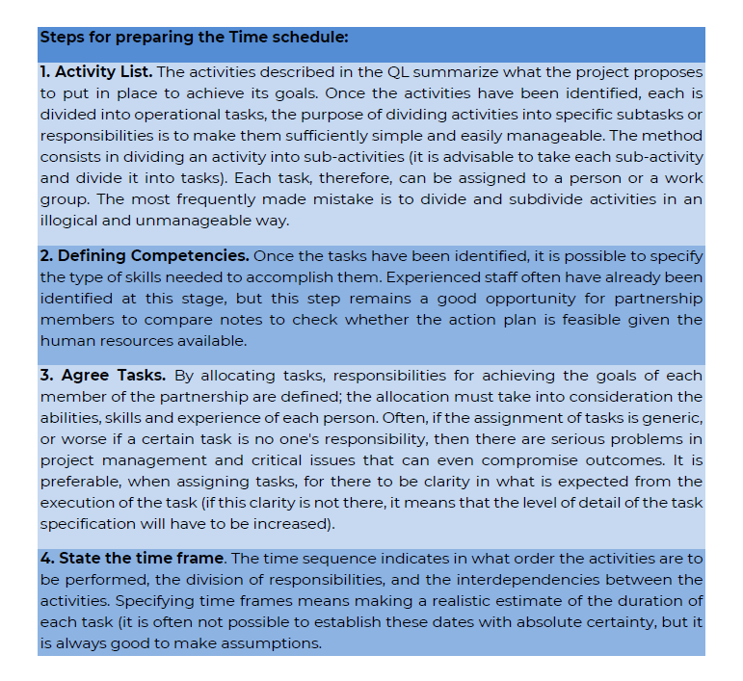
How to design a project
This presentation is part of the action “NFP4Health”
which has received funding from the European Union’s Health
Programme (2014-2020) under grant agreement No 101035965.

Slide 57
How to design a project
This presentation is part of the action “NFP4Health”
which has received funding from the European Union’s Health
Programme (2014-2020) under grant agreement No 101035965.

Slide 58
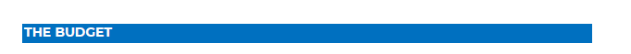

How to design a project
It is essential to check the economic feasibility and sustainability of the project. Generally, attached to the call (or internally to it) are included the rules for preparing the budget (eligible costs, ceilings, etc.), indications of funding instalments.
Once the timeline is also completed, a detailed specification and forecast of costs is made: the budget.
Each European call provides all the documents needed to fill out the expenditure tables. You should always stick to the official and provided templates and, in any case, constantly check for changes and updates. In addition, it is advisable to prepare an Excel sheet detailing each cost to be monitored constantly
This presentation is part of the action “NFP4Health”
which has received funding from the European Union’s Health
Programme (2014-2020) under grant agreement No 101035965.

Slide 59
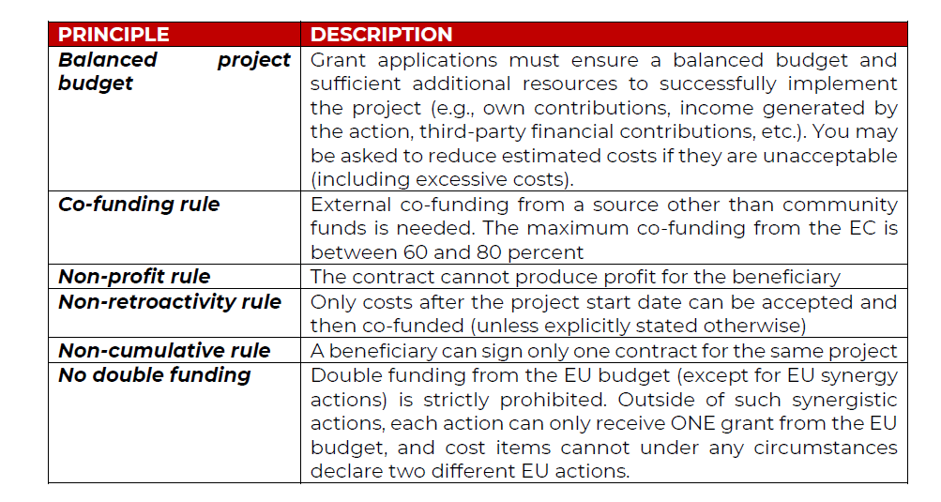
How to design a project
This presentation is part of the action “NFP4Health”
which has received funding from the European Union’s Health
Programme (2014-2020) under grant agreement No 101035965.

Slide 60
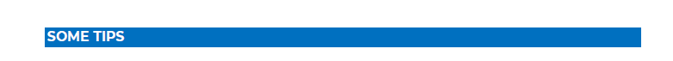
How to design a project
1. The project coordinator is never alone; it is important to involve all possible and interested parties in the development of the project idea.
2. Carefully read all provided and existing documentation, including FAQs.
3. Propose the most qualified partner (institutionally or technically) for coordination.
4. Comply with the directions on the template.
5. The proposal must be created/thought out to solve the stated problems and needs expressed (not to seek funding).
6. Writing with readability and evaluation in mind (detailed but concise, realistic and not contrived; clear and organized writing (with highlights, diagrams, charts envisaged by the form).
7. Provide a logical, correct, attention-grabbing summary. Focus on assessment criteria (e.g., read the individual assessment form used by evaluators).
8. Have someone who was not involved in drafting it read the project and, if they think that it is "complicated," unclear, and poorly written, then you should carefully consider reformulating the project proposal
This presentation is part of the action “NFP4Health”
which has received funding from the European Union’s Health
Programme (2014-2020) under grant agreement No 101035965.

Slide 61
Evaluation Tips
This presentation is part of the action “NFP4Health”
which has received funding from the European Union’s Health
Programme (2014-2020) under grant agreement No 101035965.

Slide 62
Evaluation Workflow
This presentation is part of the action “NFP4Health”
which has received funding from the European Union’s Health
Programme (2014-2020) under grant agreement No 101035965.

Slide 63
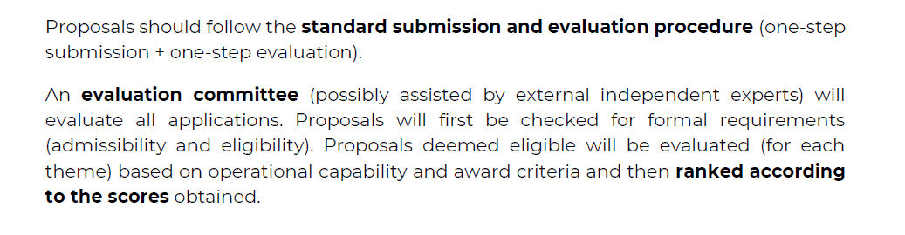

Evaluation Procedure
This presentation is part of the action “NFP4Health”
which has received funding from the European Union’s Health
Programme (2014-2020) under grant agreement No 101035965.

Slide 64


Standard Evaluation Process
Receipt of proposals
Individual evaluation
Consensus group
Panel review
Finalisation
Admissibility/eligibility
check
Experts assess
proposals individually.
All individual experts discuss together to agree on a common position, including comments and scores for each proposal.
The panel of experts reach an agreement on the scores and comments for all proposals within a call, checking consistency across the evaluations.
The Commission/Agency reviews the results of the experts’ evaluation and puts together the final ranking list.
Allocation of proposals to evaluators
Minimum of three experts per proposal (but often more than three).
if necessary, resolve cases where evaluators were unable to agree.
Rank the proposals with the same score
This presentation is part of the action “NFP4Health”
which has received funding from the European Union’s Health
Programme (2014-2020) under grant agreement No 101035965.

Slide 65
Admissibility, eligibility checks and additional requirements
Admissibility is checked by EU staff.
Applications must be complete and contain all parts and mandatory annexes and supporting documents.
Applications must be readable, accessible and printable.
Applications must include a plan for the exploitation and dissemination of results including communication activities
(n/a for applications at the first stage of two-stage procedures or unless otherwise provided in the specific call conditions).
Specific page limits per type of action normally apply (specified in the topic conditions and controlled by IT tool).
This presentation is part of the action “NFP4Health”
which has received funding from the European Union’s Health
Programme (2014-2020) under grant agreement No 101035965.

Slide 66

Evaluation Criteria
• Relevance: clarity and coherence of the project, goals and planning; correspondence with themes, priorities and goals of the call; contribution to the EU strategic and legislative context; European/transnational dimension; impact/interest for a number of countries (EU or eligible non-EU countries);
potential for use of outcomes; potential for developing mutual trust/cross-border cooperation (30 points).
• Quality: - Project design and implementation: Technical quality; logical links between identified problems, needs and proposed solutions (rationale); identified problems, needs and proposed solutions (logical framework concept); project implementation methodology (concept and methodology, management, procedures, timetable, risks and risk management, monitoring and evaluation); project feasibility within the proposed timeframe; cost-effectiveness (sufficient/adequate budget for successful implementation; best value for money) (30 points).
- Project team and modes of cooperation: quality of the consortium and project team; appropriate procedures and problem-solving mechanisms for cooperation within the project and consortium (30 points).
• Impact: ambition and expected long-term impact of outcomes on target groups/general public; appropriate dissemination strategy to ensure long-term sustainability and impact; sustainability of outcomes after EU funding ends (10 points).
This presentation is part of the action “NFP4Health”
which has received funding from the European Union’s Health
Programme (2014-2020) under grant agreement No 101035965.

Slide 67
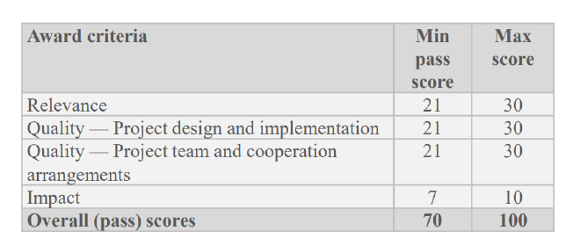
Evaluation Criteria
This presentation is part of the action “NFP4Health”
which has received funding from the European Union’s Health
Programme (2014-2020) under grant agreement No 101035965.

Slide 68
Evaluation Criteria
EXCELLENCE
Clarity and pertinence of the project’s objectives, and the extent to which the proposed work is ambitious, and goes beyond the state-of-the-art.
Soundness of the proposed methodology, including the underlying concepts, models, assumptions, inter- disciplinary approaches, appropriate consideration of the gender dimension in research and innovation content, and the quality of open science practices including sharing and management of research outputs and engagement of citizens, civil society and end users where appropriate.
IMPACT
Credibility of the pathways to achieve the expected outcomes and impacts specified in the work programme, and the likely scale and significance of the contributions due to the project.
Suitability and quality of the measures to maximize expected outcomes and impacts, as set out in the dissemination and exploitation plan, including communication activities.
QUALITY AND EFFICIENCY OF THE
IMPLEMENTATION
Quality and effectiveness of the work plan, assessment of risks, and appropriateness of the effort assigned to work packages, and the resources overall.
Capacity and role of each participant, and extent to which the consortium as a whole brings together the necessary expertise.
Proposals aspects are assessed to the extent that the proposed work is within the scope of the work programme topic
This presentation is part of the action “NFP4Health”
which has received funding from the European Union’s Health
Programme (2014-2020) under grant agreement No 101035965.

Slide 69


Does the consortium have the necessary expertise to achieve the project goals or are there gaps?
Evaluation Criteria
Tip
What a partner looks like?
What characteristics should it have?
What information to enter in the partner file?
This presentation is part of the action “NFP4Health”
which has received funding from the European Union’s Health
Programme (2014-2020) under grant agreement No 101035965.

Slide 70

Evaluation Criteria
PARTNER FORM…
This presentation is part of the action “NFP4Health”
which has received funding from the European Union’s Health
Programme (2014-2020) under grant agreement No 101035965.

Slide 71
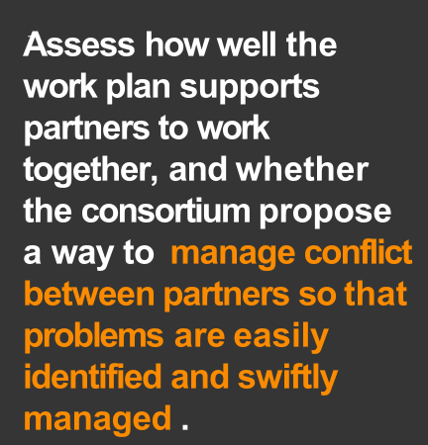
Evaluation Criteria
From the external expert…
Tip
Management Plan
Risk assessment and measure to solve conflicts
This presentation is part of the action “NFP4Health”
which has received funding from the European Union’s Health
Programme (2014-2020) under grant agreement No 101035965.

Slide 72




Evaluation Criteria
END USER… TARGET
This presentation is part of the action “NFP4Health”
which has received funding from the European Union’s Health
Programme (2014-2020) under grant agreement No 101035965.

Slide 73
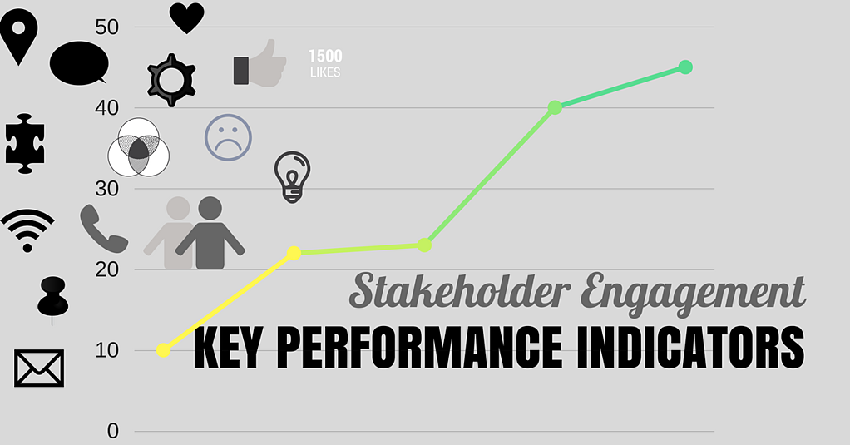
Evaluation Criteria
Stakeholders
The stakeholders define the approach and level of detail required by the KPI.
Each has different interest, knowledge, and action capabilities, hence the data they require from the project differs. Consequently, the KPI definition requires correctly identifying the relevant stakeholders at each stage of the project. :
• Technology developers
• Technology integrators
• Health system.
• Local public authorities
• Policy makers
The KPIs for particular product/technology should be useful for technology developers while the system KPIs should serve to technology integrators and utilities, but also to public administration, to check the health, economic, and social impacts of the system.
This presentation is part of the action “NFP4Health”
which has received funding from the European Union’s Health
Programme (2014-2020) under grant agreement No 101035965.

Slide 74
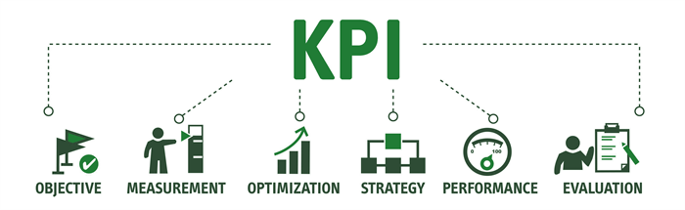
Evaluation Criteria
This presentation is part of the action “NFP4Health”
which has received funding from the European Union’s Health
Programme (2014-2020) under grant agreement No 101035965.

Slide 75
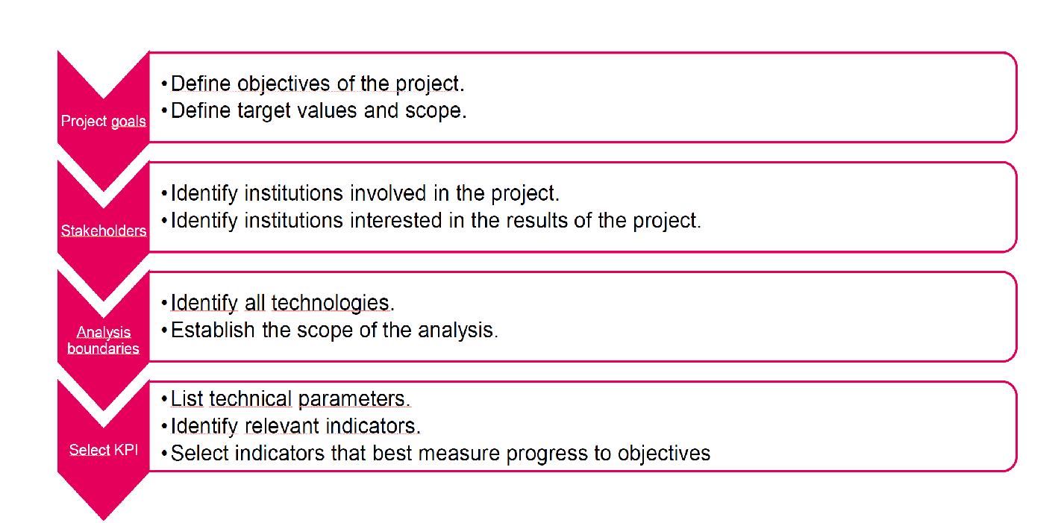
Evaluation Criteria
This presentation is part of the action “NFP4Health”
which has received funding from the European Union’s Health
Programme (2014-2020) under grant agreement No 101035965.

Slide 76






For more information:
EU4Health programme 2021-2027
https://health.ec.europa.eu/funding/eu4health-programme-2021-2027-vision-healthier-european-union_en
This presentation is part of the action “NFP4Health”
which has received funding from the European Union’s Health
Programme (2014-2020) under grant agreement No 101035965.

Slide 77
THANK YOU!
This presentation is part of the action “NFP4Health”
which has received funding from the European Union’s Health
Programme (2014-2020) under grant agreement No 101035965.

