Slide 1
JA-PreventNCD
Lessons from a newcomer
Arve Paulsen, project manager Norwegian Directorate of Health
This presentation is part of the action “NFP4Health” which has received funding from the European Union’s Health Programme (2014-2020) under grant agreement No 101035965.

Slide 2
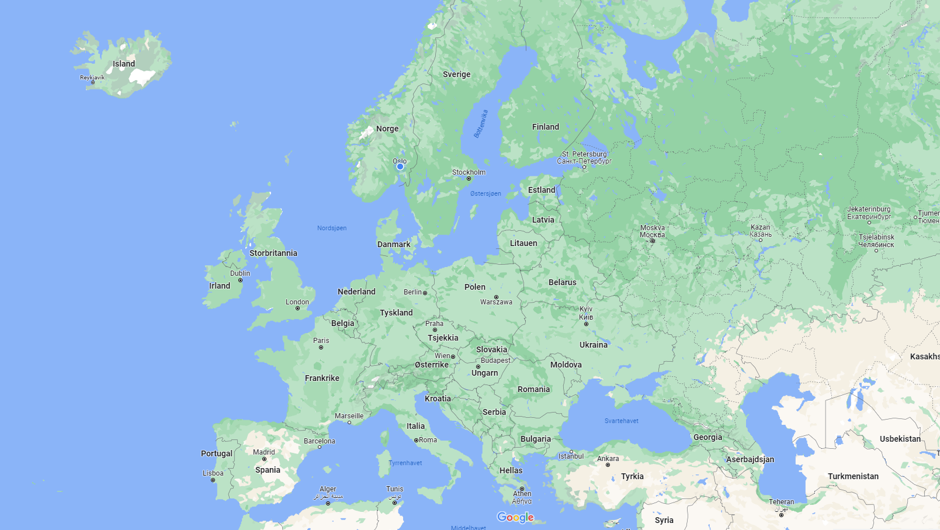
MEUR1 spread
25 countries
98
pilots
60
tasks
113
subtasks
99 partners
10
work packages

Slide 3
JA-PreventNCD - specific objectives
To improve joint capacities of MSs to plan and implement cancer and other NCD prevention policies and activities both at a national, regional, and local level.
To improve data and the monitoring system for cancer and other NCDs and their common risk factors.
To contribute to reduced social inequalities in cancer and other NCDs.
Engage with and support key actors in the field of cancer and NCD prevention, including decision makers at all levels of government, civil society organizations, professionals, the general population, and patients’ groups to facilitate cooperation and joint efforts.
This presentation is part of the action “NFP4Health” which has received funding from the European Union’s Health Programme (2014-2020) under grant agreement No 101035965.

Slide 4
Lessons learned
A lot of work
Bigger ja => more PMs spent on preparation
The more inexperienced => the more PMs spent on preparation
However, many will help you
Teams collaboration platform
Holiday season is not holiday season. There are seasons. And days
Different working styles, and ability to deliver
Importance of defining the difference between AE and AP at an early stage (+ mandatory requirements for AE)
Contact data management
How big is a kick-off?
This presentation is part of the action “NFP4Health” which has received funding from the European Union’s Health Programme (2014-2020) under grant agreement No 101035965.

Slide 5
What we all can do
Respond ASAP and adequately to requests from the Coordinator
Stick to the production plan and deliver input according to it
Get aquainted to, and use actively, the digital platform provided for online collaboration. Ja-PreventNCD: Teams
Keep sharing experiences. Thanks to all who shared their insight and allowed us to tap into their knowledge
This presentation is part of the action “NFP4Health” which has received funding from the European Union’s Health Programme (2014-2020) under grant agreement No 101035965.

Slide 6
HaDEA – please keep doing as today
Active and proactive HaDEA project officer with close contact to HaDEAs financial office
Short, weekly status meetings for big and small clarifications in pre-grant phase
This presentation is part of the action “NFP4Health” which has received funding from the European Union’s Health Programme (2014-2020) under grant agreement No 101035965.

Slide 7
HaDEA – please consider
Prepare Coordinator on how much time and resources are needed before the JA starts
Two-day startup workshop HaDEA + Coordinator
Reuse data from EU portal into Consortium Agreement.
«Leanification» (institution names, contact persons)
API?
Provide additional resources to Coordinator
Pre-grant funding for taking on the duty
Higher EU funding ratio for the Coordinator
Standard Consortium Agreement that will be effective at a given date, should the Consortium not be able to agree on their own CA within a given time
This presentation is part of the action “NFP4Health” which has received funding from the European Union’s Health Programme (2014-2020) under grant agreement No 101035965.

Slide 8
One question
The role of Open call grants, there has been little interaction/involvement in the matter. Is not knowing them the best approach? Risk of overlaps and little cooperation.
This presentation is part of the action “NFP4Health” which has received funding from the European Union’s Health Programme (2014-2020) under grant agreement No 101035965.

Slide 9
Notes:
Strupenbreen i Lyngen

